Slide 1
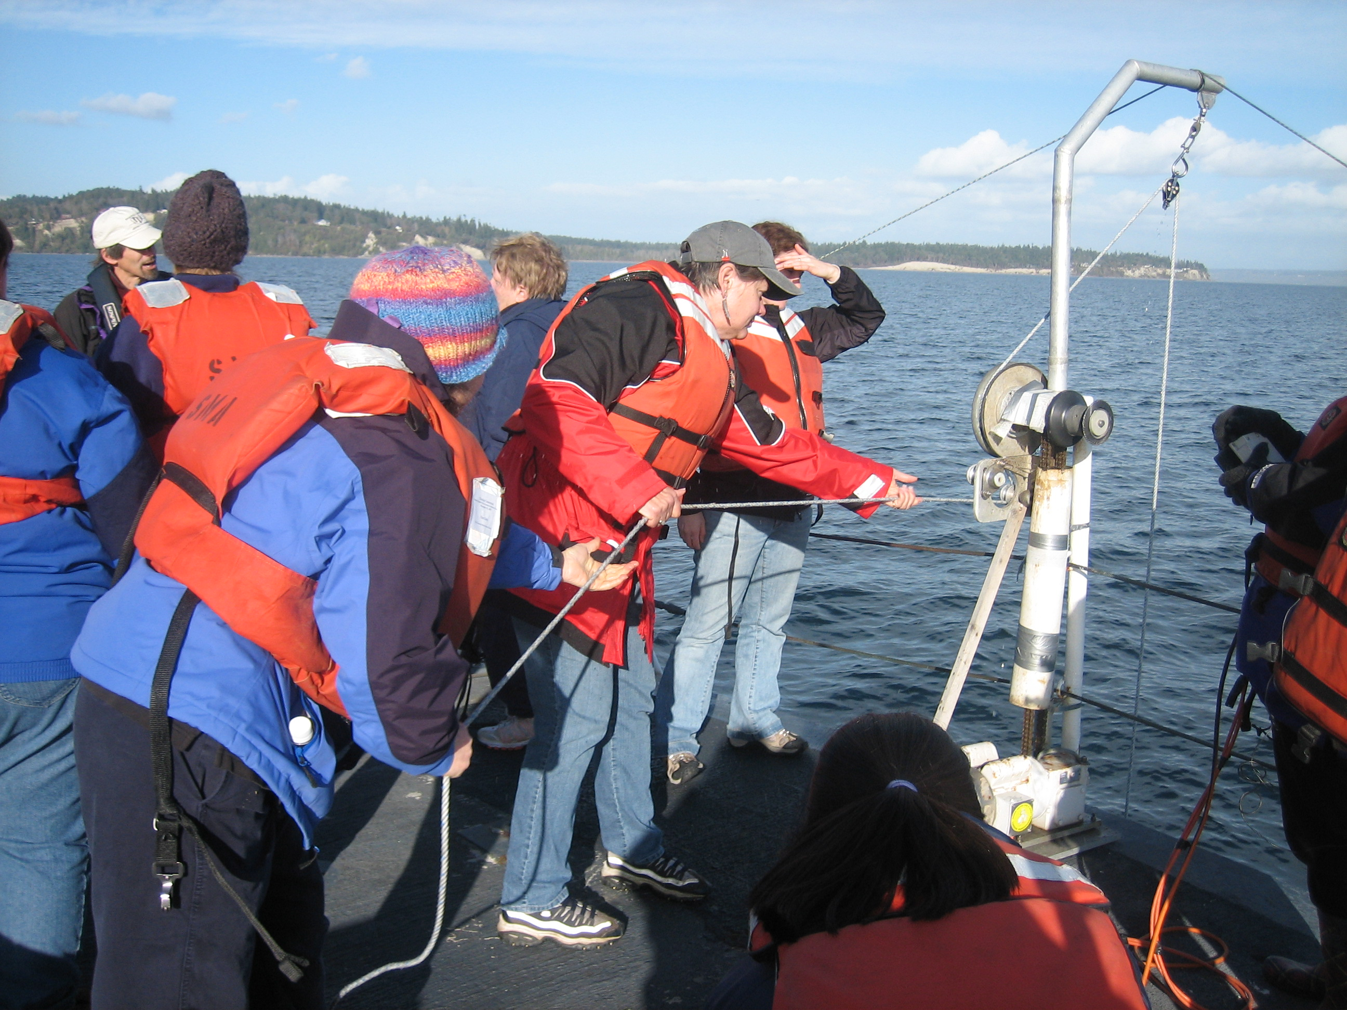
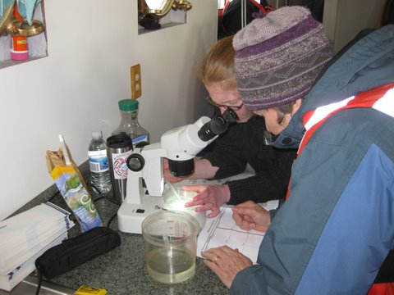
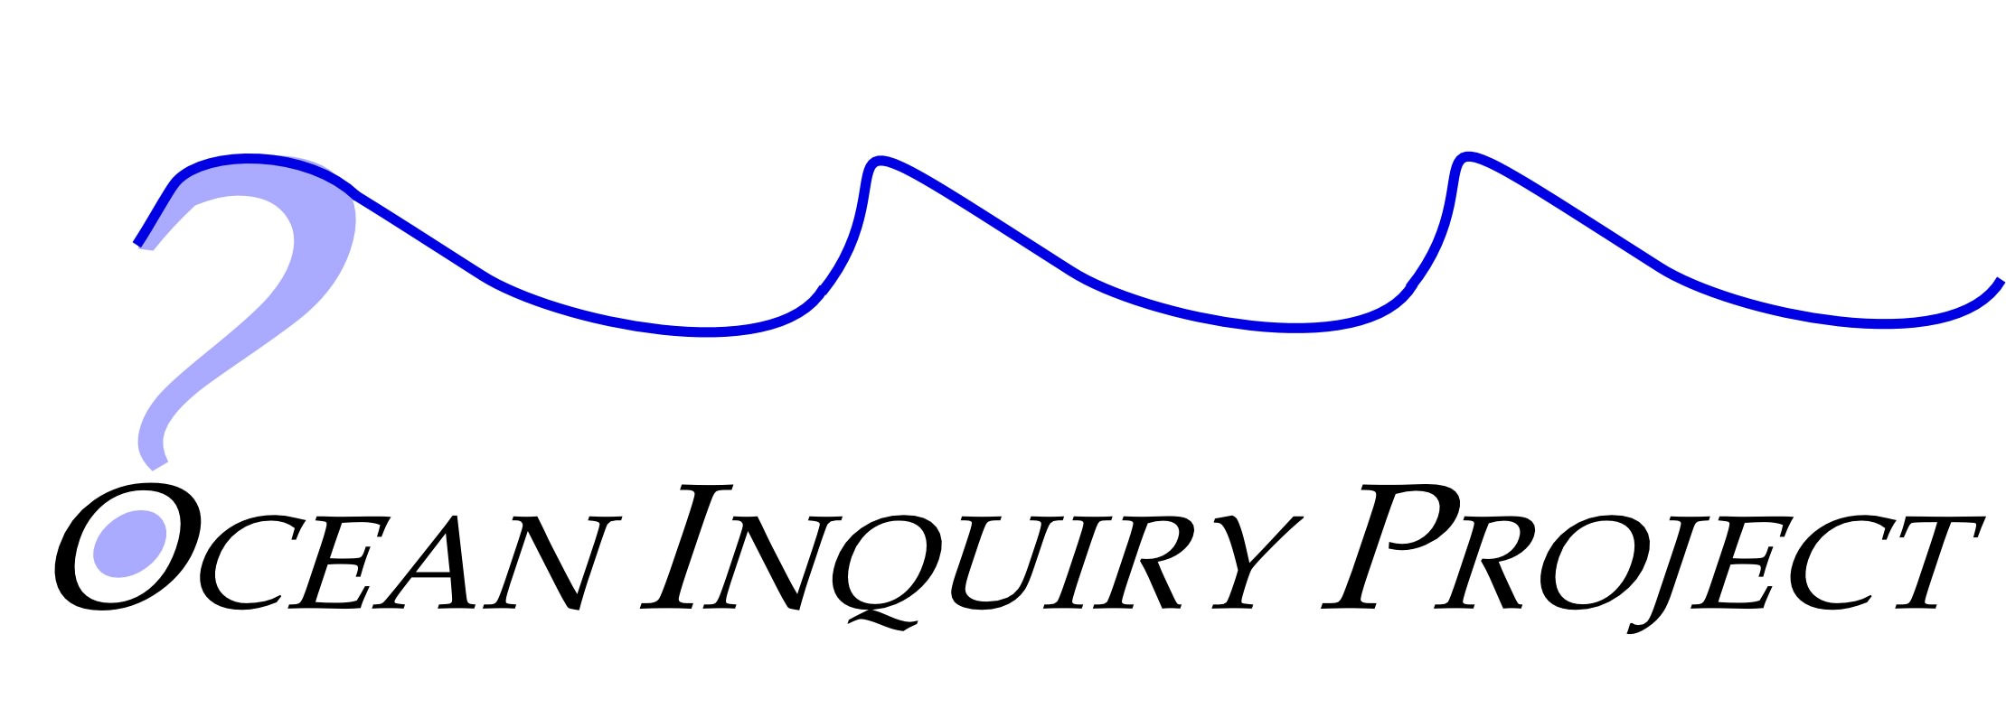
Bringing Ocean Researchers and Marine Volunteers Together Through Field Research
Amy Sprenger, Program Director
Fritz Stahr, President

Slide 2
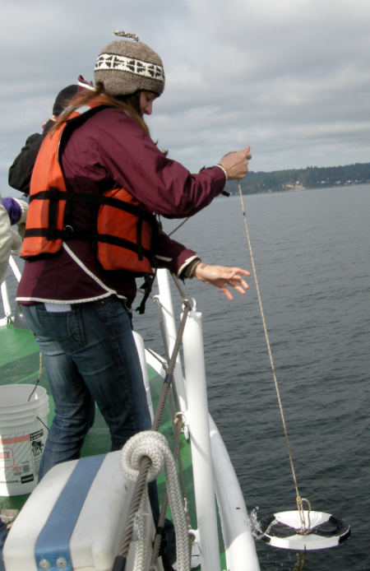
What is Ocean Inquiry Project (OIP)?
Independent non-profit, established in 2000 to fill two needs:
Lack of experiential learning opportunities for oceanography students
Lack of data in a complex fjord-estuary (Puget Sound)
Notes:
Through the ocean learning communities: • Citizens learn about current ocean research;
• Ocean scientists improve communication of their research;
• Volunteers have opportunities to learn about and participate in ocean research;
• Learning scientists investigate how people learn and teach marine science.

Slide 3
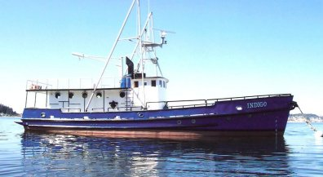
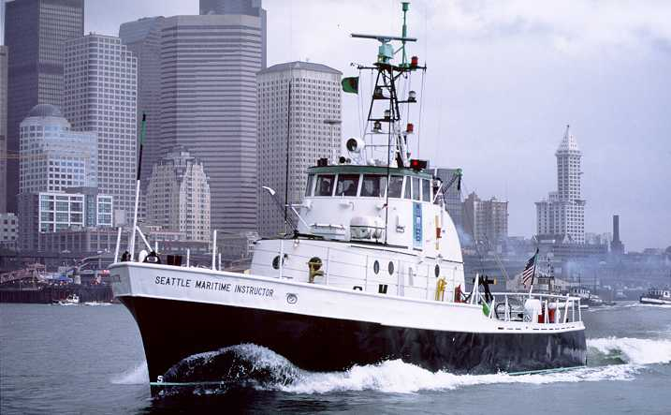
OIP Model
Teach marine science through one-day, on-the-water experiences
Participate in ongoing research projects in Puget Sound
OIP instructors are marine science graduate students, undergraduates, and working scientists

Slide 4
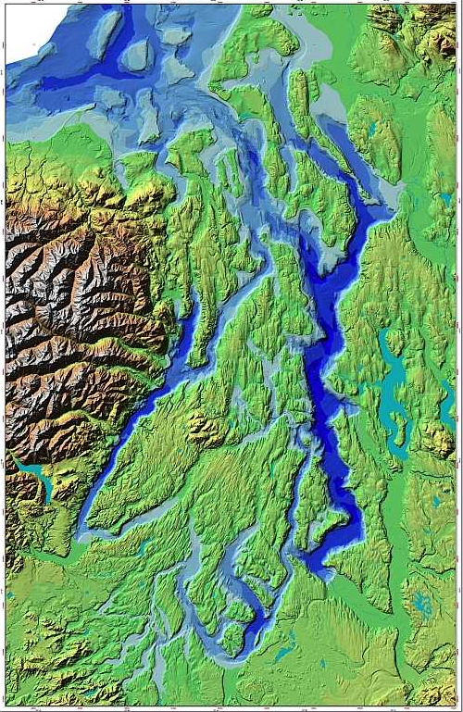
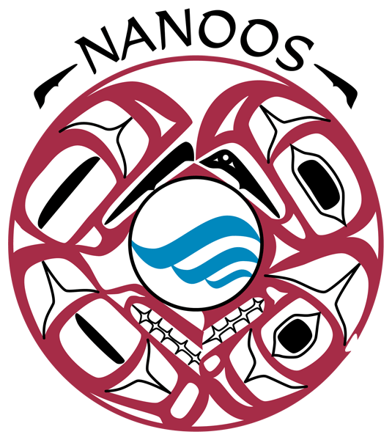
Research and Learning Activities
CTD casts
Water sampling
Plankton tows
Seattle
Tacoma
Olympia
Puget Sound, WA
Notes:
Visit 3 to 4 stations
Stations chosen are based upon WA DOE marine water monitoring and University of Washington stations
You can see here our three most visited hydrographic lines, Commencement Bay near Tacoma, PS main basin near Seattle and up along admiralty inlet near Port Townsend and Whidbey island
As move from station to station participants rotate through 3 core activities –
CTD cast
Surface and deep plankton tows
Water sampling and testing with niskin bottles
While collecting samples and deploying instruments, OIP instructors work with participants to make hypothesis expect to see in data and samples
And then

Slide 5
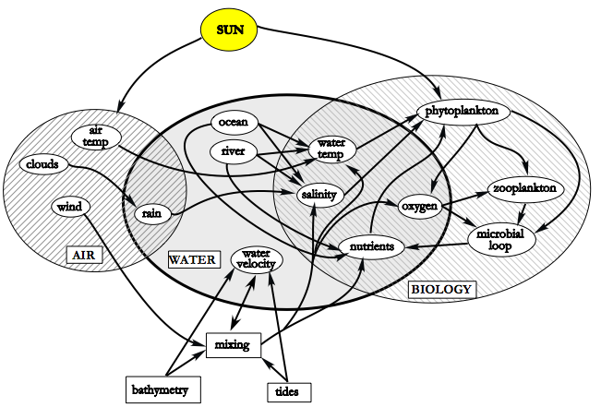
Research and Learning Activities

Slide 6
COSEE-OLC and OIP
Through Ocean Learning Communities:
Citizens learn about current ocean research
Ocean scientists improve communication of their research
Volunteers have opportunities to learn about and participate in ocean research
Learning scientists investigate how people learn and teach marine science

Slide 7
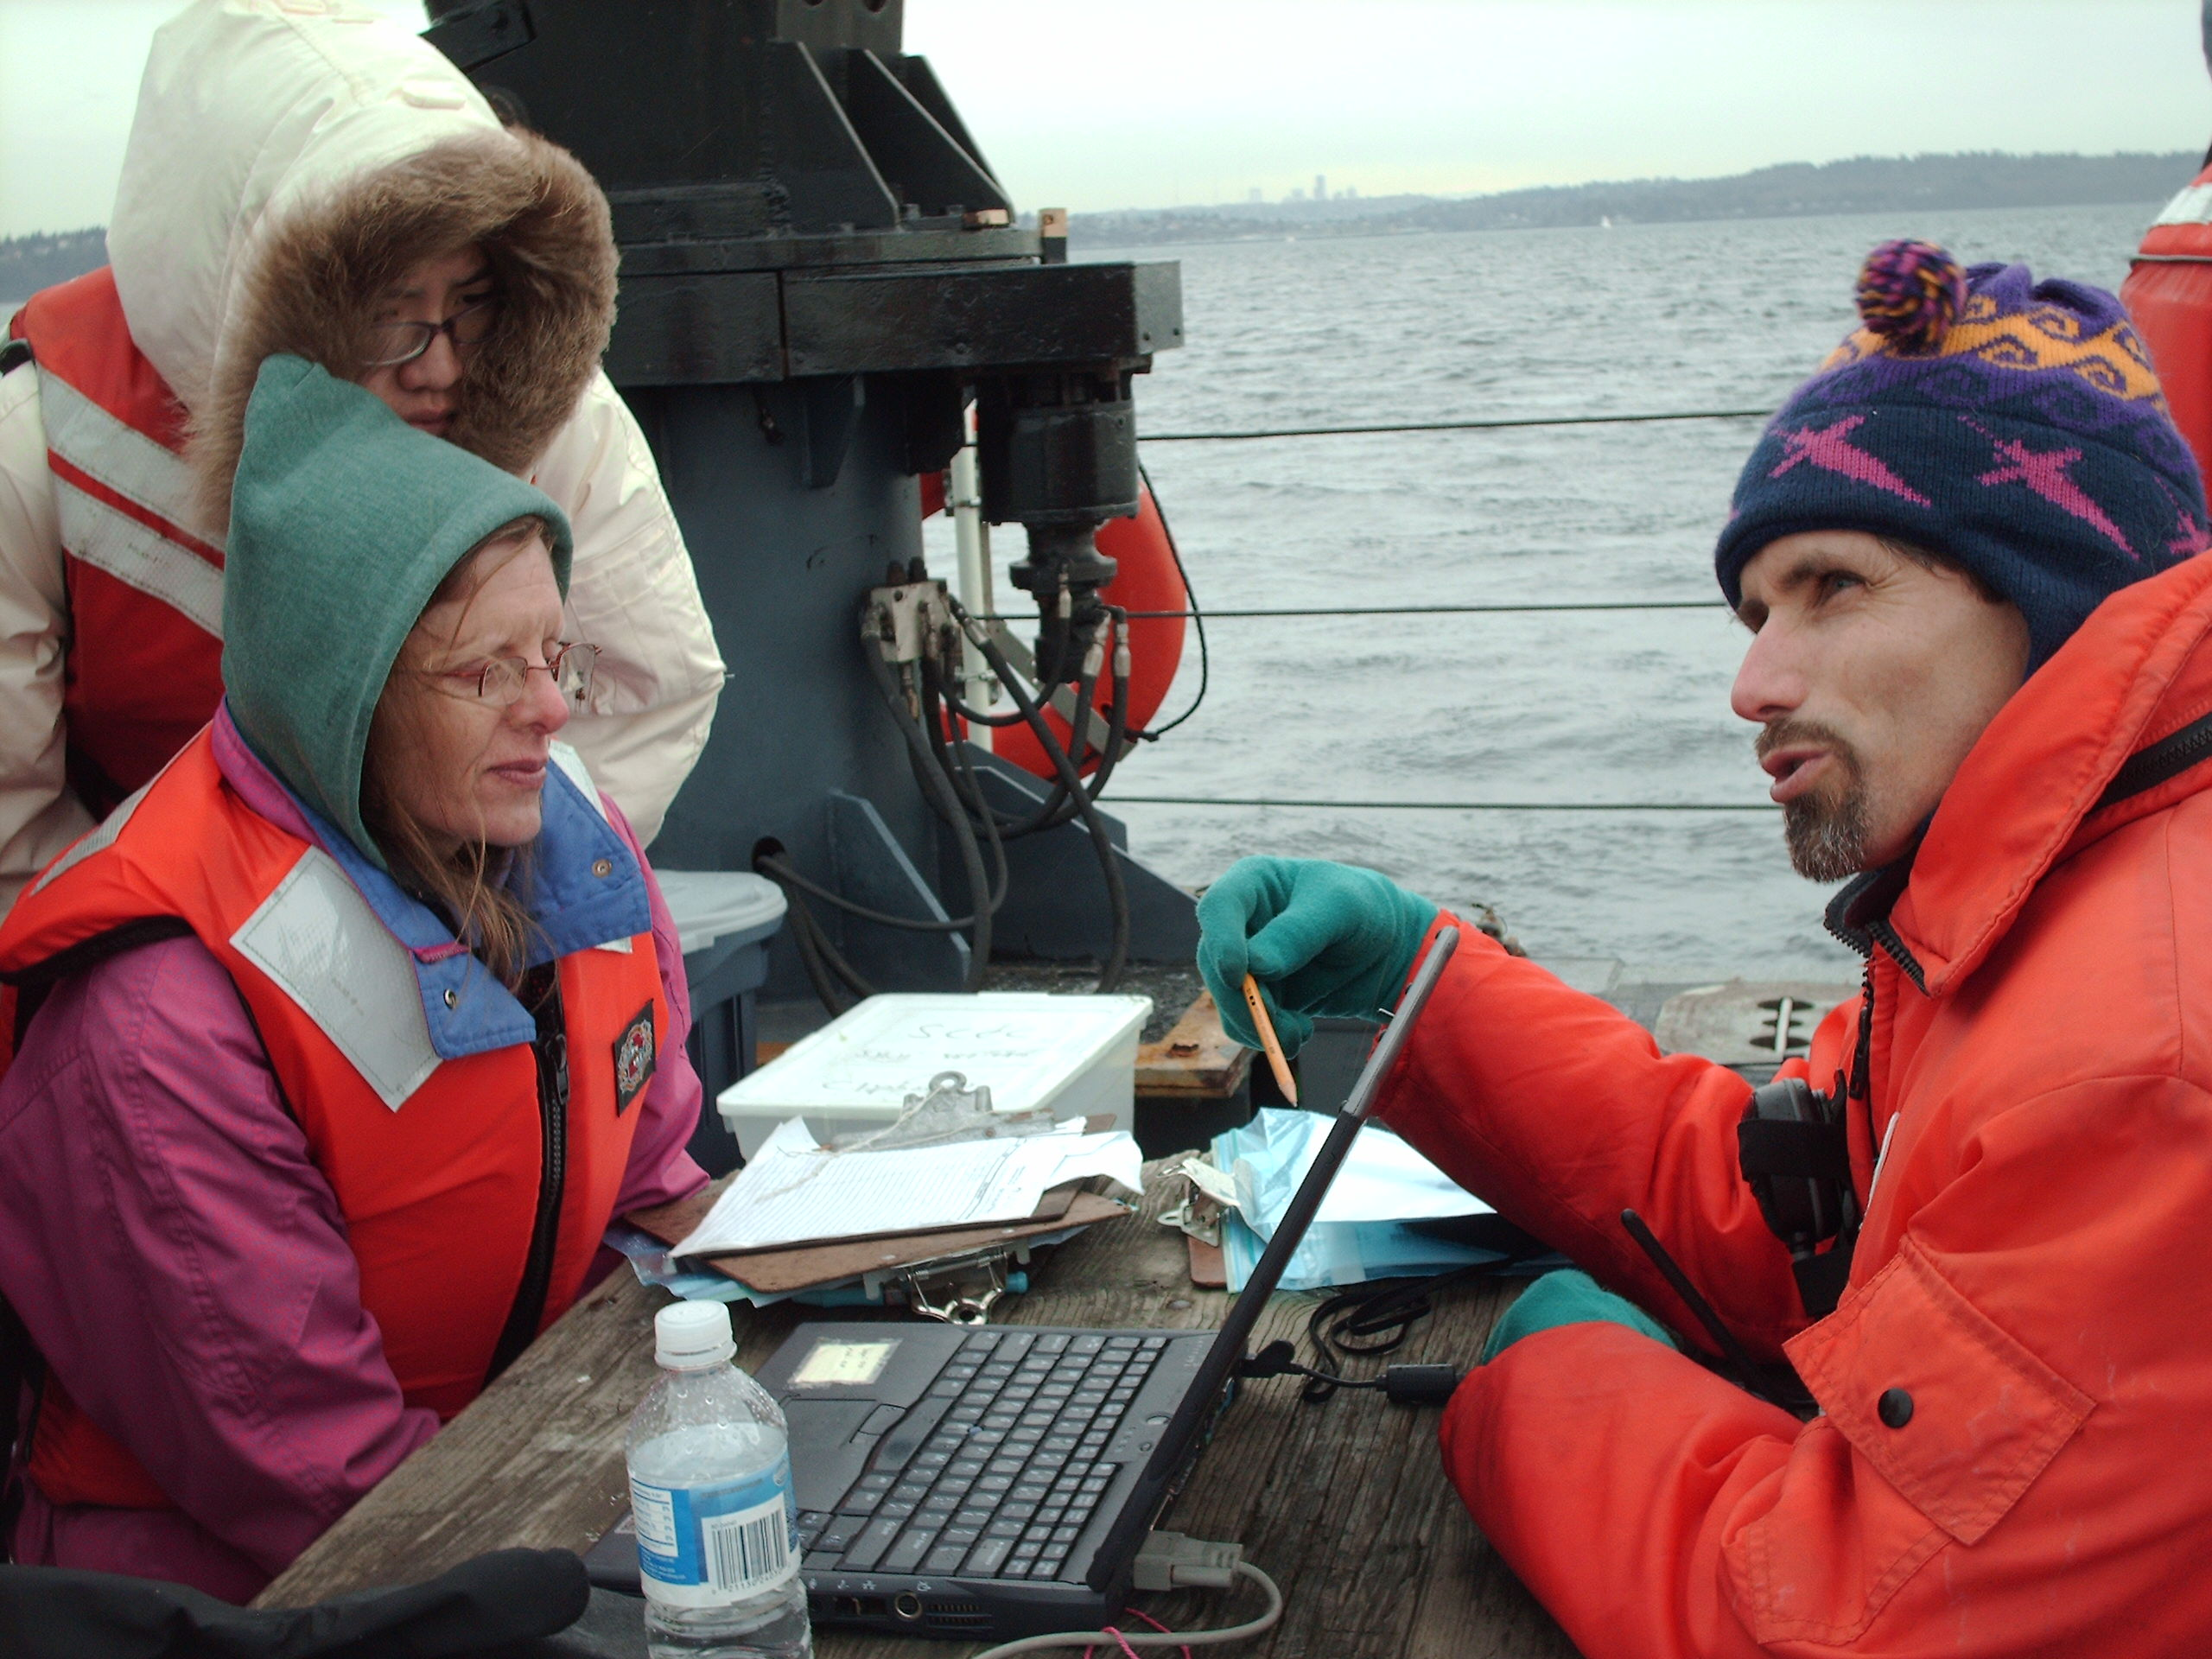
Collaboration Goals
Two-way communication between marine volunteers and scientists in a non-academic, real world setting
Increase marine volunteers’ ocean science knowledge
Promote better understanding of oceanographic research and techniques
Make new connections between ocean scientists and diverse groups of non-scientists.
Scientists gain experience delivering material to non-scientific audiences
Notes:
the skills of delivering ocean literacy and knowledge to non-scientist audiences by young oceanographers, and their gain in local knowledge, new perspectives, questions to ponder, and potential connections to local groups interested in their science.
Collaborating with OIP will provide research cruises as a vehicle for interaction between volunteer based
organizations, local businesses groups, and ocean scientists. The cruises facilitate two-way
communication between volunteers and scientists in a non-academic, real world setting. COSEEOLC
learning community members benefit through acquisition of ocean science knowledge, better
understanding of oceanographic research and techniques, the impact of large-scale oceanographic
processes on their work, and new connections with ocean scientists. Participating scientists will gain
experience by delivering material to non-scientific audiences, seeing new perspectives and
questions to ponder, and making new connections to local groups interested in science.
Collaborating to provide field learning experiences will augment the range of learning experiences
that COSEE-OLC is developing and testing. The two-way interaction through a field experience
furthers the overarching goal of the center to cultivate functional, contributing and ocean-literate
citizens who are aware of the impact oceans have on their daily lives. With this approach, the center
progresses toward building a common language among diverse groups to promote science-based
ocean education and learning at the public level.

Slide 8
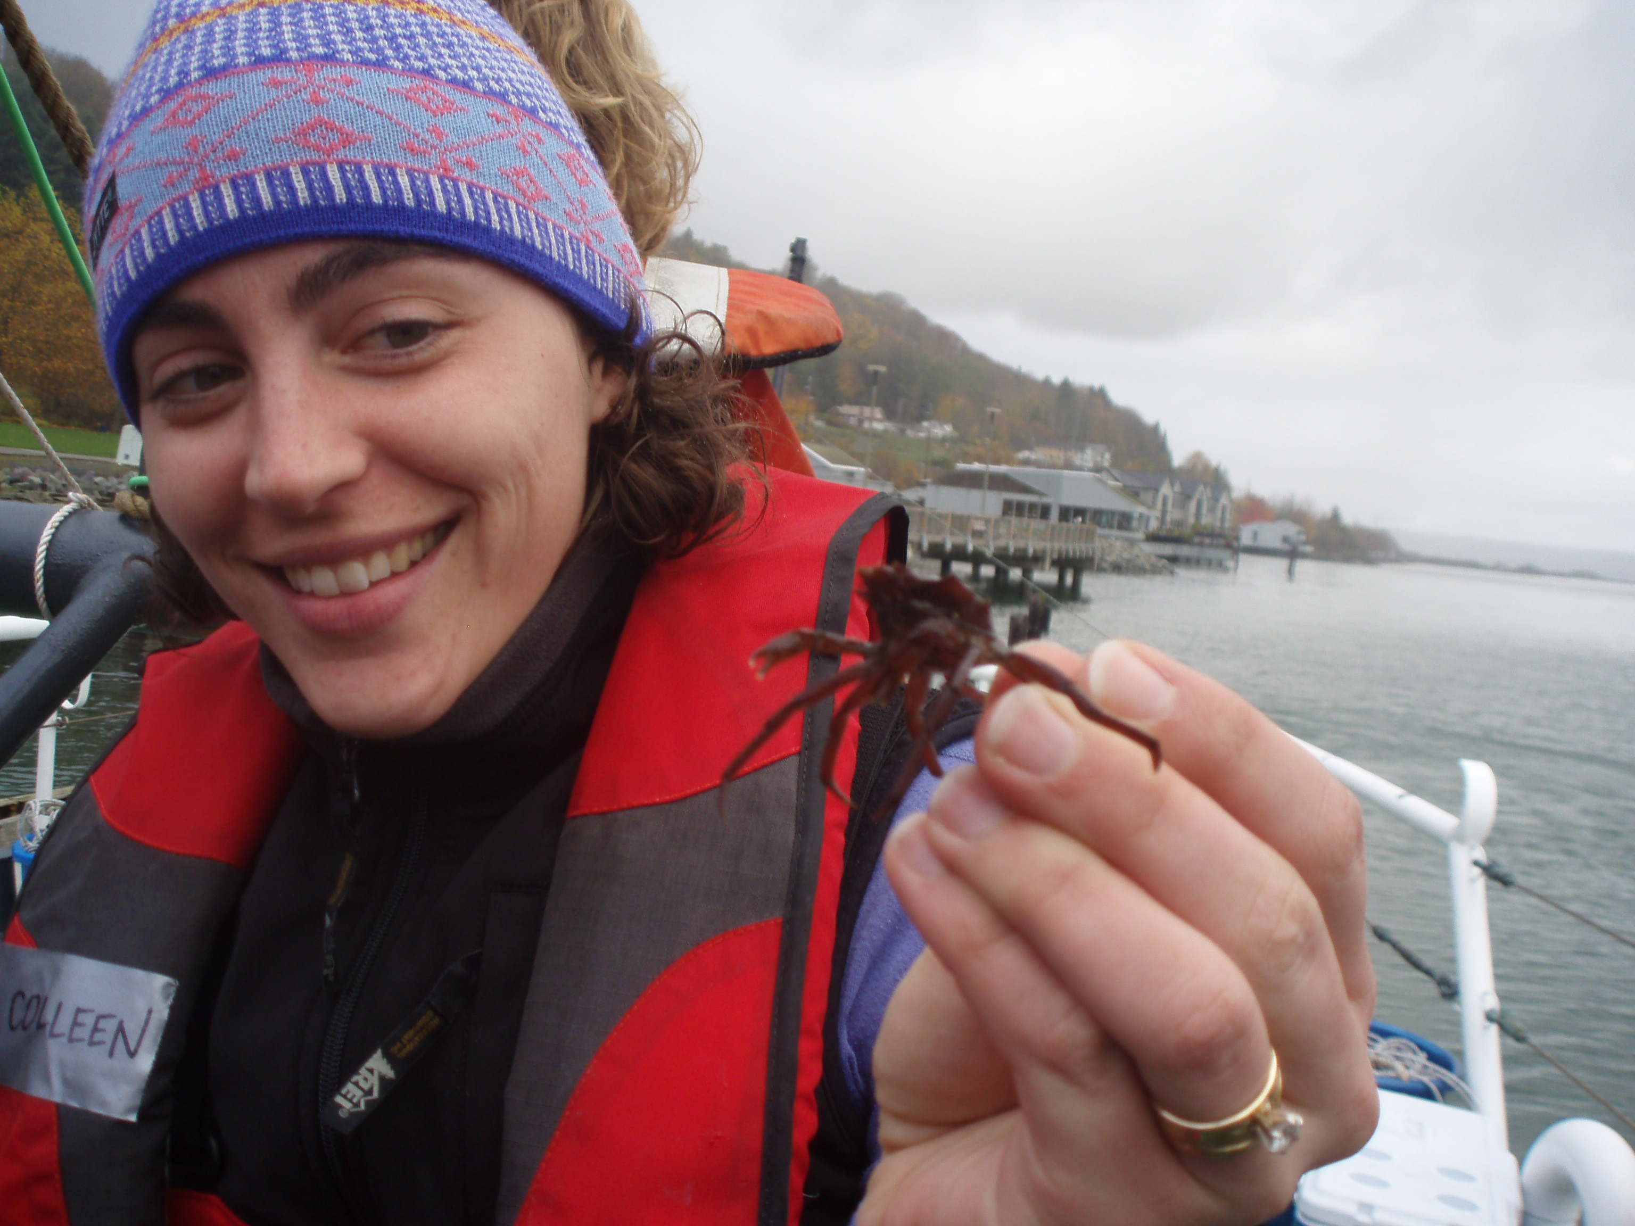
2009 Field Season
Intent:
To provide first-hand ocean science research learning experiences for members of the ocean learning community.
By:
Providing one-day research cruises for members of the marine volunteer community including:
Beach naturalists
Citizen scientists
Restoration volunteers
Interpreters at local aquariums

Slide 9
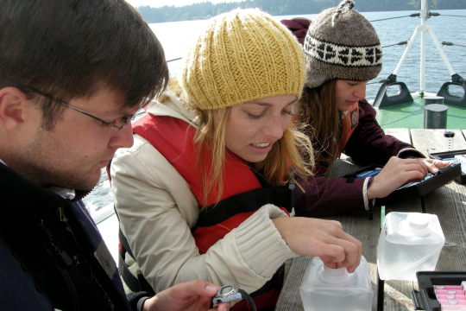
2009 Field Season Recap
14 COSEE OLC sponsored cruises throughout Puget Sound
320 cruise participants
48 CTD casts
70 SoundCitizen water samples

Slide 10
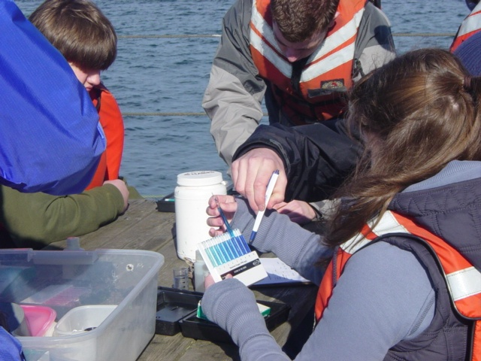
Evaluation of Marine Volunteer Cruise Participants
Were the cruises:
Useful?
Relevant?
Interesting?
The evaluation also sought to understand:
What participants learned from the cruises
How participants might integrate the experience into their volunteer activities
Notes:
The evaluation also sought to understand what participants learned from the cruises and what they wanted to know more about. For the marine volunteers the evaluation also tried to understand how the volunteers might integrate the experience into their volunteer activities.

Slide 11
Marine Volunteer Participant Demographics
Percent of Respondents
Gender
Age
“Silver tsunami”

Slide 12
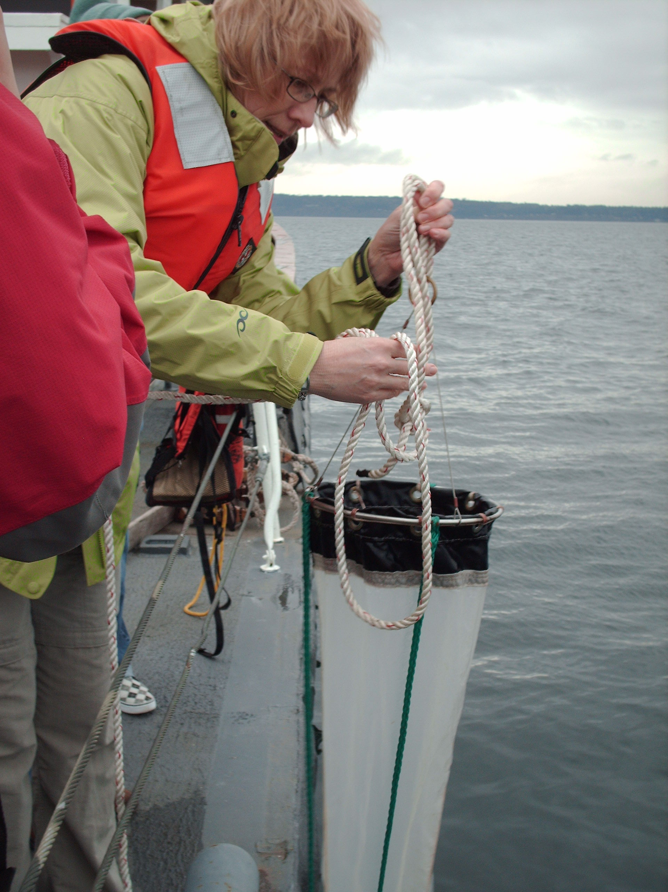
Outcomes - Marine Volunteers
Usefulness of Cruises to Marine Volunteers
Notes:
Combined data from the seven individual cruises reported below shows that participants said they found the cruises to be very useful. Overall, 83% rated the usefulness as either a 4 or 5

Slide 13
Outcomes - Marine Volunteers
Relevance of Cruises to Marine Volunteers
Notes:
Combined data from the seven individual cruises reported below shows that participants said they found the cruises to be very useful. Overall, 83% rated the usefulness as either a 4 or 5

Slide 14
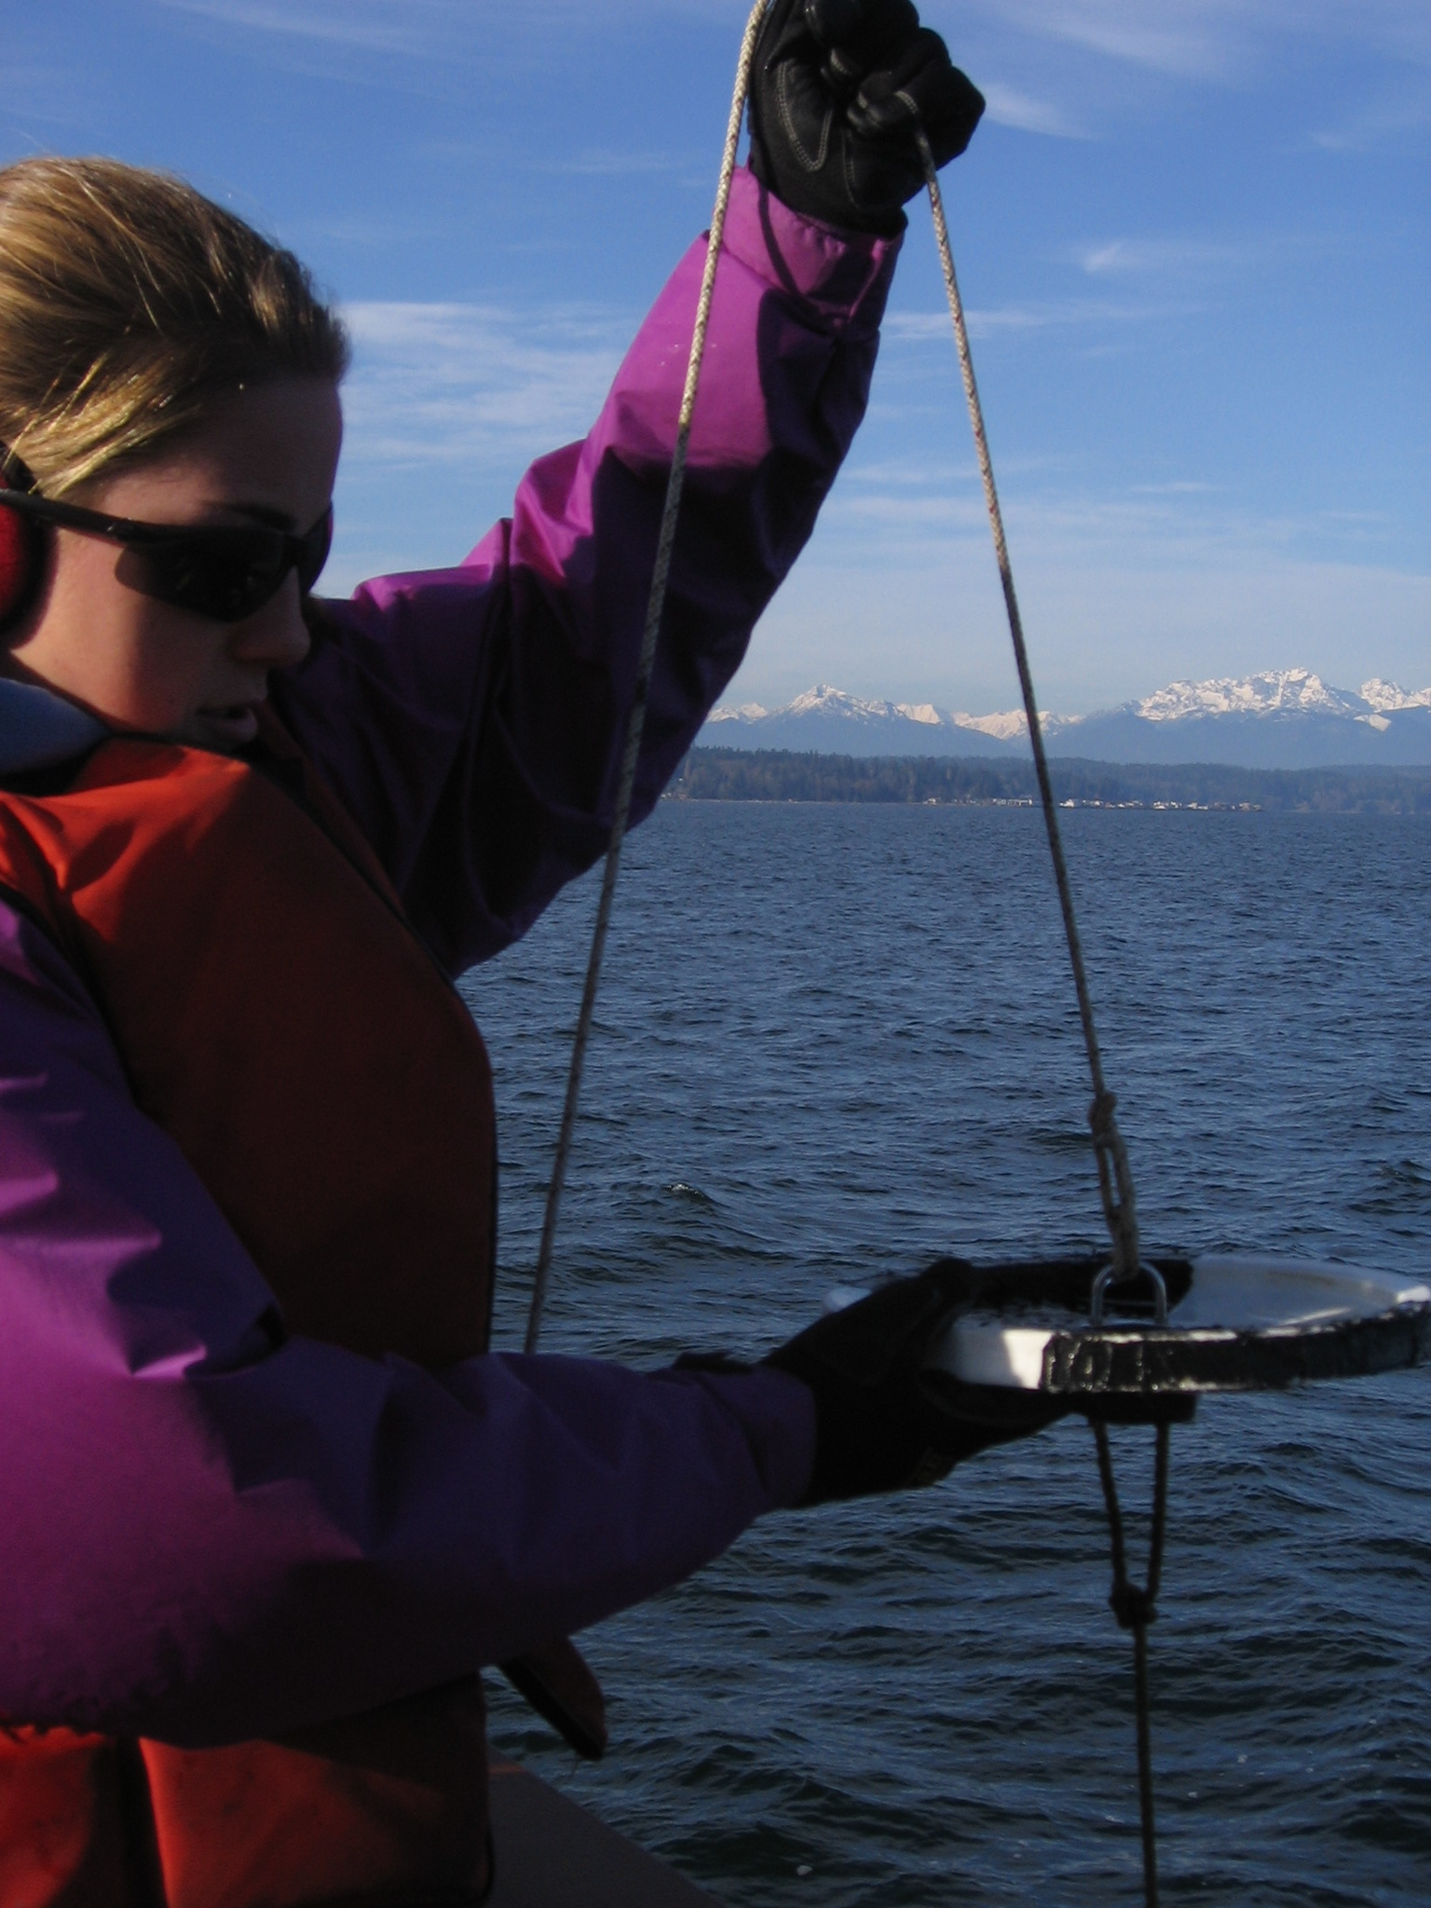
Reflections from Marine Volunteers
“The ability to actually do something that will/could be used for research studies is extremely exciting.” “I learned about salinity, conductivity and many other properties of water and how/why they are relevant to an ecosystem.”
Notes:
Cruise participants gained skills, knowledge, and an increased capacity to share “Before running test or doing draws, etc. Decide what you think you'll find; forming a hypothesis and then run test. Upon completion relate back to hypothesis and interpret results”
Volunteer on Citizen Science Symposium Cruise

“That basic testing and data collection will build data bases for indicators of trends - man made and natural.”
Volunteer on Anacortes cruise

“Interactions and examination of many factors contribute to the overall picture of ocean health…. “
-Volunteer on Seattle cruise

“how interconnected everything is and the importance of what we put down the drain”
-Volunteer on Harbor WildWatch cruise

“I learned a lot about the chemical properties of the ocean; how they are different in the Puget Sound from the open ocean. I learned more about plankton and their effects on the water. There's a vast amount of things to study”
“some of the current methods used to measure important data points and relevance of the data to different applications; water testing—what chemicals, salts, CO₂, O₂, temperature is in (sic) the water”
-Volunteers on Seattle cruise

“I learned about salinity, conductivity and many other properties of water and how/why they are relevant to an ecosystem.”
“About monitoring techniques and reasons for its relevance to Puget Sound. I'm always amazed at how the public's so fascinated with larval stage animals and the phyto- and zoo plankton under the microscopes.”
-Volunteer Teen Naturalists

with the public.

Slide 15
Reflections from Marine Volunteers
“Since volunteers focus on beach specimens at low tide, this showed us how to think anew. Asking questions, making predictions, and then testing to see if we are right. This new knowledge of phytoplankton and zooplankton, and water temperatures at various depths will be fun to share.” “A better understanding of the underwater environment is a better basis for explaining what happens on the beach”
Notes:
Cruise participants gained skills, knowledge, and an increased capacity to share “Before running test or doing draws, etc. Decide what you think you'll find; forming a hypothesis and then run test. Upon completion relate back to hypothesis and interpret results”
Volunteer on Citizen Science Symposium Cruise

“That basic testing and data collection will build data bases for indicators of trends - man made and natural.”
Volunteer on Anacortes cruise

“Interactions and examination of many factors contribute to the overall picture of ocean health…. “
-Volunteer on Seattle cruise

“how interconnected everything is and the importance of what we put down the drain”
-Volunteer on Harbor WildWatch cruise

“I learned a lot about the chemical properties of the ocean; how they are different in the Puget Sound from the open ocean. I learned more about plankton and their effects on the water. There's a vast amount of things to study”
“some of the current methods used to measure important data points and relevance of the data to different applications; water testing—what chemicals, salts, CO₂, O₂, temperature is in (sic) the water”
-Volunteers on Seattle cruise

“I learned about salinity, conductivity and many other properties of water and how/why they are relevant to an ecosystem.”
“About monitoring techniques and reasons for its relevance to Puget Sound. I'm always amazed at how the public's so fascinated with larval stage animals and the phyto- and zoo plankton under the microscopes.”
-Volunteer Teen Naturalists

with the public.

Slide 16
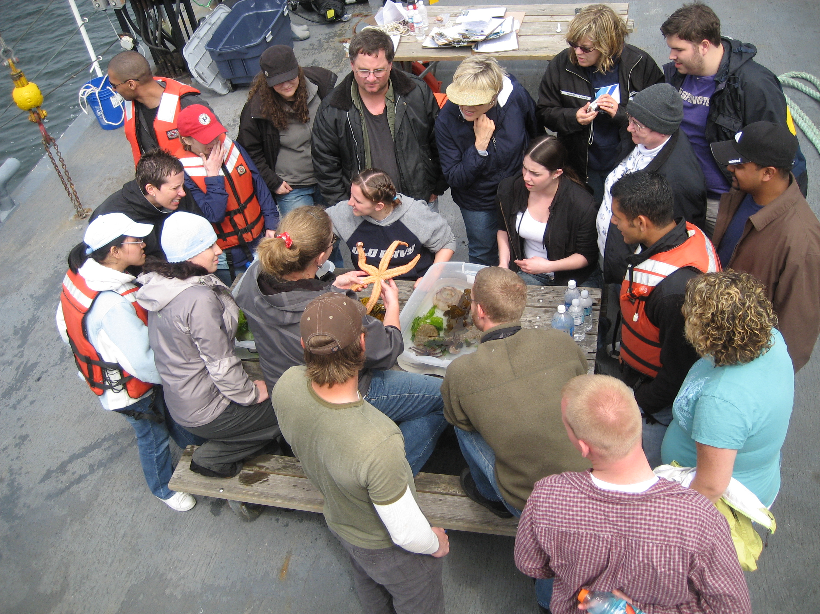
Findings from the Marine Volunteers
Cruises are relevant and useful
Cruise participants gained skills, knowledge and an increased capacity to share with the public
Volunteers assimilate the first-hand learning experiences
Marine volunteers contribute to ocean science education, and receive little acknowledgement of their important role
Notes:
There may be many hundreds of marine volunteers working with aquariums and other informal learning organizations across the nation. They contribute hours, knowledge, skills and passion for marine sciences. Volunteers collect baseline data, interact with the public, and teach classes of school children about the marine environment. Despite what they contribute to the ocean science education system, volunteers are largely overlooked in this important role.
Support of marine volunteers is a high priority aim for COSEE-OLC and the Ocean Inquiry Project. Both COSEE-OLC and OIP create opportunities for volunteers to learn about ocean science.

Slide 17
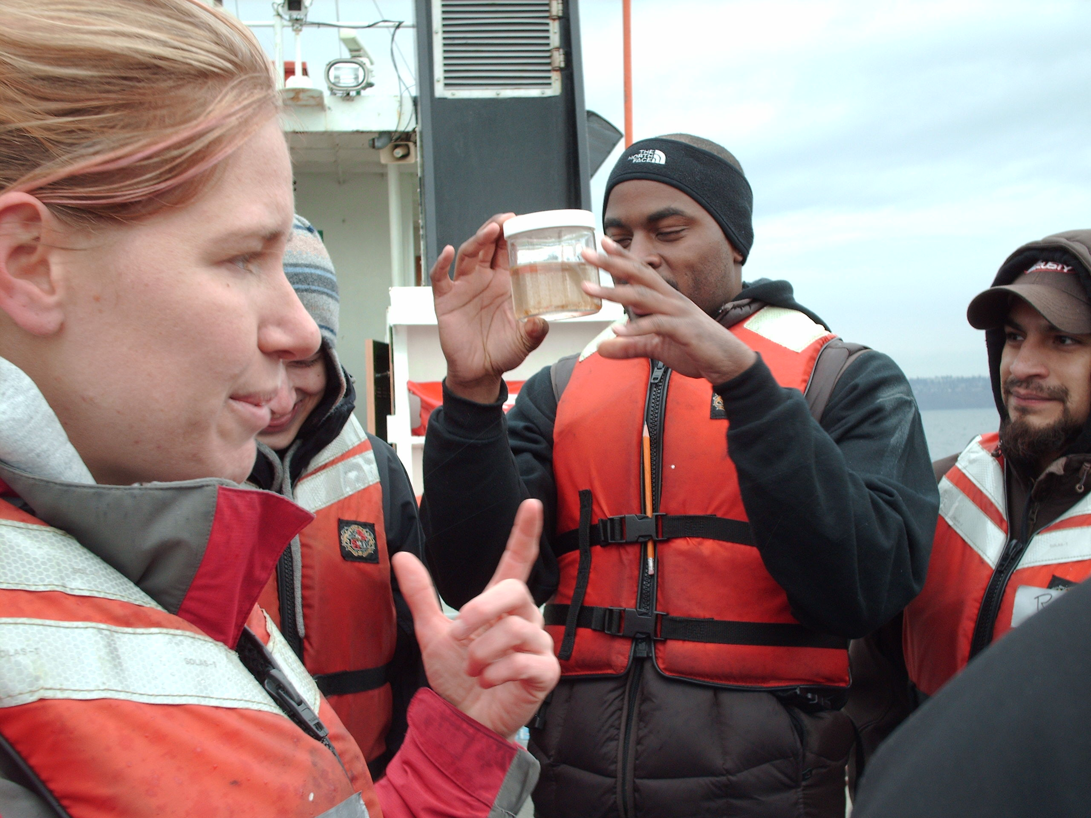
Acknowledgements
Thank You!
OIP Volunteers and the entire COSEE OLC team
Service, Education and Adventure and the M/V Indigo
Seattle Maritime Academy and the M/V Maritime Instructor
National Science Foundation

Slide 18
Evaluation of OIP Instructors
Why do OIP instructors volunteer for the OIP cruises?
Are they enjoyable?
We hope so!
In 2009 we had 25 OIP instructors
volunteer a total of 87 times
For 2010 we anticipate a minimum of 16 cruises, needing OIP instructors to volunteer at least 96 times
Notes:
The evaluation also sought to understand what participants learned from the cruises and what they wanted to know more about. For the marine volunteers the evaluation also tried to understand how the volunteers might integrate the experience into their volunteer activities.

Slide 19
Outcomes – OIP Instructors
Enjoyment rating by OIP Volunteers
Percent of Respondents

Slide 20
Outcomes – OIP Volunteers
What motivates you to volunteer on these OIP cruises?
“learning, educating and being part of a community”
“Interaction with the public/youth –
teaching and learning myself. “
“Being able to go out on the boat to
teach oceanography. “
“Mainly the overall interactive environment”

Slide 21
Findings from the OIP Instructors
OIP volunteers really enjoy working the cruises
OIP volunteers are motivated by an interest in teaching, participants’ learning and a passion for nature

Slide 22
Next Steps

