Slide 1
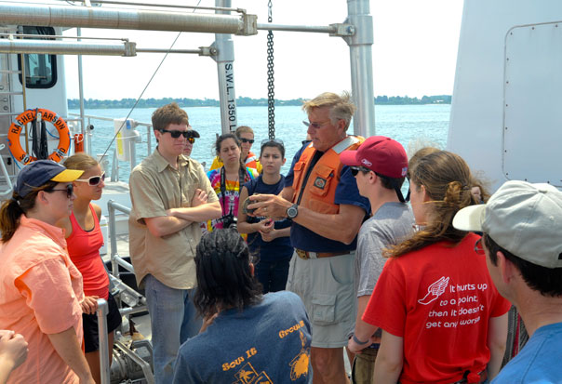
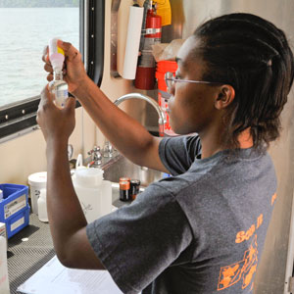
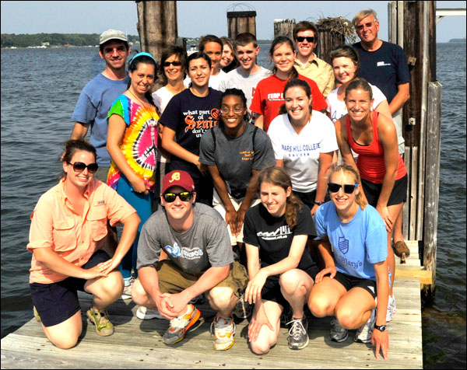
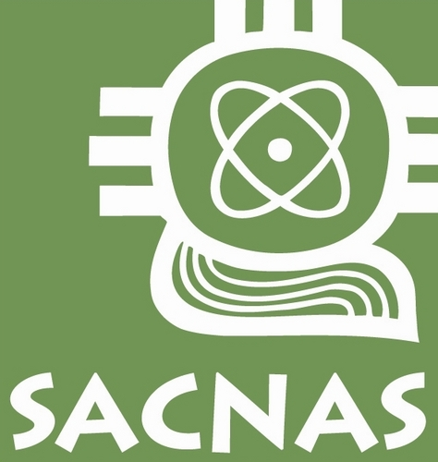
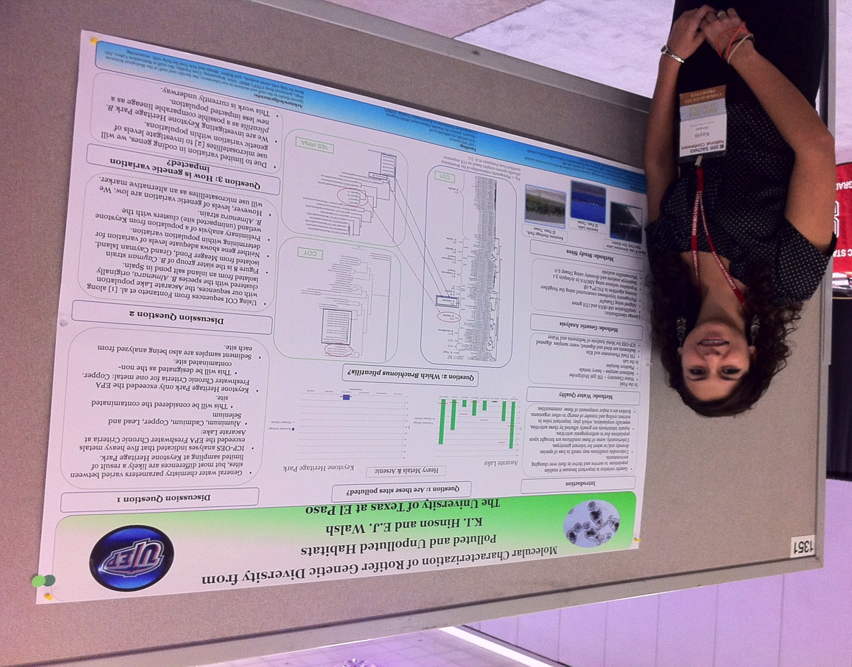
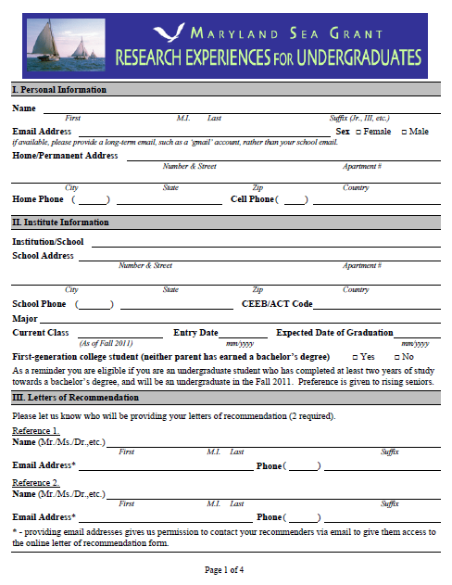
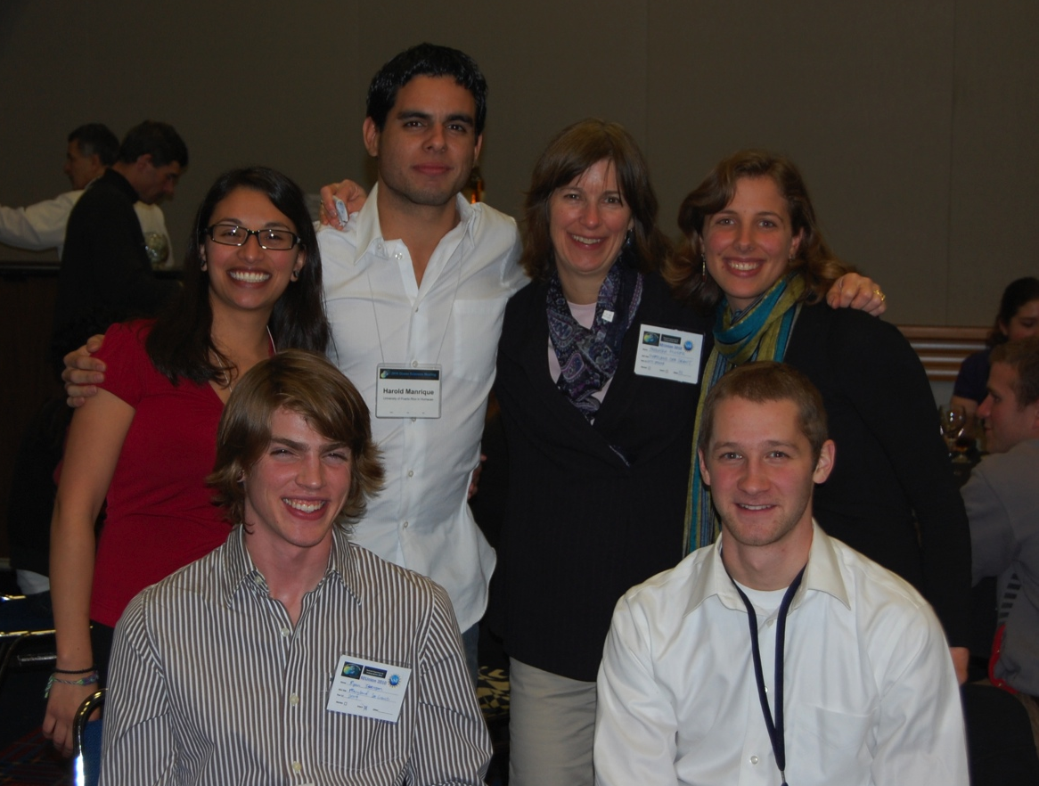
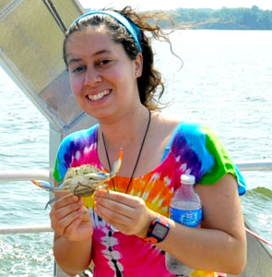
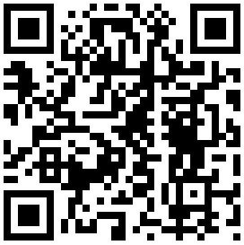
Strategies for Broadening Participation in the Maryland Sea Grant REU Program
Fredrika Moser*, Jonathan Kramer and Jenna Clark
Maryland Sea Grant, University System of Maryland
4321 Hartwick Road Suite 300, College Park, MD 20740, United States
Maryland Sea Grant strives to provide students from underrepresented groups in marine science opportunities to participate in its NSF-supported Research Experiences for Undergraduates (REU) program in estuarine science. While women dominate the applicant/accepted student pool, we are testing different strategies to increase the number of students from underrepresented groups in our program. We use such strategies as: 1) developing trust and partnerships with faculty at minority serving institutions; 2) expanding our outreach in advertising our program; 3) recruiting potential applicants at professional meetings; 4) targeting minority serving institutions within and beyond our region; 5) encouraging our REU alumni to promote our REU program among their peers; and 6) improving our application process. These strategies contribute to improved diversity and composition of our student pool. To help sustain long-term outcomes, we are exploring ways to work directly with minority-serving institutions to build ‘bridging REU programs’ that can train prospective REU students and thus enlarge the pool of potential applicants to recruit.
Sustain Long-Term Outcomes
Abstract
REU Underrepresented Applicants’ Majors
REU Underrepresented Applicants’ Home Institutions
Keeping REU alumni connected with Facebook and listserv allows long-term mentorship
Participating in ASLOMP builds long-term network and support systems
Linking students to resource web sites provides long-term opportunities
Collaborating with minority serving institutions increases student application rate to REU programs and long-term access to marine science
WA
MT
ND
MN
India
ME
OR
ID
SD
WI
MI
NY
VT
NH
MA
NV
WY
NE
IA
IL
IN
OH
PA
DE
NJ
CT
RI
CA
UT
C O
KS
MO
KY
WV
VA
MD
D C
5
AZ
NM
OK
AR
TN
SC
NC
TX
LA
MS
AL
GA
Professional Meetings
Virgin
Islands
FL
1 -2
3-5
6-10
11-20
21-40
> 41
AK
HI
PR
Recruitment opportunities for potential applicants to the REU program
Peer interaction among REU alumni
Opportunities for REU alumni to present their research and interact within the scientific community
Annual REUnion brings alumni together
Gender of REU Underrepresented Applicants by Year and Race
Year | % of Underrepresented Groups
2005 | 18%
2006 | 25%
2007 | 37%
2008 | 22%
2009 | 28%
2010 | 17%
2011 | 16%
Improving the Application Process
Email program information to over 2,600 researchers
Email to over 400 HBCUs and NACUs contacts
Targeted calls to recruit applicants from underrepresented groups
Multiple web sites link to our REU web site
Revised online application designed using the nearly barrier-free ‘Common Application’ model
Detailed guidance for completing application
http://www.mdsg.umd.edu/programs/research/reu/apply/form/
Bridging Partnerships with
Minority Serving Institutions
We continue to build regional ties with small colleges and minority serving institutions to increase awareness about marine science and encourage more applicants from underrepresented groups.
Check out our website!

