Slide 1
THE GRADUATE STUDENTS FOR OCEAN EDUCATION (GROE) FACEBOOK PAGE: USING SOCIAL MEDIA TO CREATE A BROADER IMPACTS COMMUNITY
Hayley N. Schiebel¹, Robert F. Chen¹ and Catherine Cramer²
¹School For the Environment, University of Massachusetts, Boston
²New York Hall of Science
hayleyschiebel@gmail.com
COSEE: BROADENING IMPACTS
COSEE Mission: “Scientists and educators working together to advance ocean discovery and make known the vital role of the ocean in our lives”.
COSEE National Network: Composed of 15 Centers, nearly 100 Universities, nearly 100 Informal Science Centers, 100s of ocean scientists, 1000s of educators, 10s of school districts, and a National Coordinating Office.
NSF Criterion II: Broader Impacts of your research—educational activities, public outreach, scientists partnering with educators, developing activities, programs, exhibits, media, etc.
Future of COSEE: COSEE will continue as the Consortium for Ocean Science Exploration and Engagement, a national network of ocean scientists and educators that links cutting-edge ocean science with the outreach and education needed to increase ocean literacy among diverse audiences.
Social Networking: How do we broaden the reach of COSEE to ensure opportunities for all scientists?
ENGAGING USERS
Facebook Ads: First ad launched March 15, 2013 (exponential increase of users).
Science Cafés: Provide face-to-face interaction that can be continued online. First one in Boston in August, 2013 (20 graduate students); second in Wood’s Hole in November, 2013 (50 graduate students).
Engaging Networks: Sharing the page among professional, social, and academic networks increases reach from a trusted source. High quality posts keeps users engaged.
Facebook Ideas: Photo posts get 39% more interaction. Shorter posts get 23% more interaction. Using emoticons increases comments by 33%. ☺ ☺ ☺ Engagement rates on Thursday and Friday are 18% higher. Question posts get 100% more comments. 35% of Facebook Fans like a page so they can participate in contests.
GrOE has steadily increased the number of users who post, but has not yet established a highly interactive professional learning community.
*These pie charts are generated from 2013 NSF data.
GrOE User Demographics
THE GrOE FACEBOOK PAGE
https://www.facebook.com/COSEEGrOE
COSEE OCEAN believes graduate students represent the future of ocean science on a national level, yet graduate students are isolated under the guidance of a single advisor within a program within a university.
Not all advisors or programs or universities are connected with COSEE and its resources.
Graduate students are interested in pursuing broader impacts of their research and are exploring many career paths.
Graduate students connect through Facebook.
The GrOE Facebook page was launched in February, 2011 to create a forum for graduate students interested in ocean education.
GrOE provides information about ocean education opportunities as well as surveys, caption contests, and a communication tool.
As of January, 2014, GrOE has over 4,000 users.
LESSONS LEARNED
Facebook Ads greatly increase “Likes”.
Multiple active “nodes” (people with different networks) increases page activity.
Social media is useful to continue communication for existing networks and to greatly increase the pool of passive watchers.
The above chart is from exported data from the GrOE Facebook page. Daily Users indicates the number of people who “like” the page and follow GrOE.
NERD NITE: HONOLULU
When: Wednesday, February 26, 2014!
Where: Rumours Night Club
(Ala Moana Hotel)
410 Atkinson Drive, Honolulu
What: Speakers, cash bar and food provided! No cover!
FUTURE OF GrOE
Twitter account starting soon.
Spreading GrOE through existing networks.
Contests: Video submissions, photos of fieldwork, lab notebook pages. Requesting action for prizes from students.
Sustainability: GrOE will be maintained by students for students, so will continue after funding has ended.

Slide 2
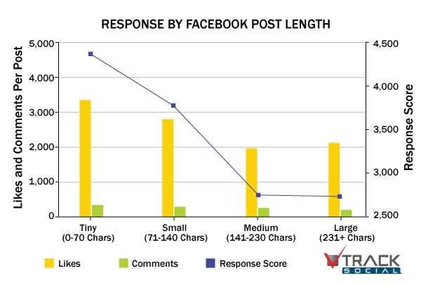
ABSTRACT
COSEE Ocean Communities in Education And social Networks (OCEAN) promotes ocean literacy and engages ocean scientists in seeking broader impacts for their research. Graduate students nationally represent the future of ocean science research in academic, government, and non-profit sectors. However, doctoral research is generally conducted in isolation under the guidance of a single major advisor. Our hypothesis is that many graduate students today are interested in seeking broader impacts of ocean science research but are unaware of the opportunities and are not connected to the facilitators that could help them become involved. In February, 2011, COSEE OCEAN initiated a Facebook page for graduate students. Graduate students for Ocean Education (GrOE) is committed to becoming a reliable information hub for a growing network of graduate students who are interested in ocean science education and outreach. Since its inception, GrOE has grown to over two thousand users sharing everything from fellowship opportunities to news articles. GrOE has begun to hold in-person "science cafes" to increase the strength of interactions among this professional learning community.
BROADER IMPACTS
Since 1997, the National Science Foundation (NSF) will not even consider a proposal unless it explicitly includes activities to demonstrate the project's 'broader impacts' (BI) on science or society at large. The NSF review criteria are as follows:
Integrating research and education,
Broadening participation of underrepresented groups,
Enhancing infrastructure for research and education,
Broad dissemination of scientific ideas and methods (general scientific literacy),
Direct benefit to society,
Increased partnerships between academia, industry,
Improved national security, and
Increased economic competitiveness of the U.S.
COSEE strives to implement these BI goals via facilitation of connections with a network in order to provide enhanced resources and enable ocean science to be shared on a global scale. GrOE in particular has implemented a Facebook page and a variety of face-to-face events to foster this network among ocean science graduate students.
BACKGROUND: OCEAN LITERACY
Ocean literacy is an understanding of the ocean’s influence on you and your influence on the ocean. An ocean-literate person:
Understands the essential principles and fundamental concepts about the functioning of the ocean
Can communicate about the ocean in a meaningful way
Is able to make informed and responsible decisions regarding the ocean and its resources
In October 2005, several national organizations including NOAA, COSEE, College of Exploration, and The National Marine Educators' Association published a list of 7 Essential Principles and 44 Fundamental Concepts that currently define Ocean Science Literacy.

