Slide 1
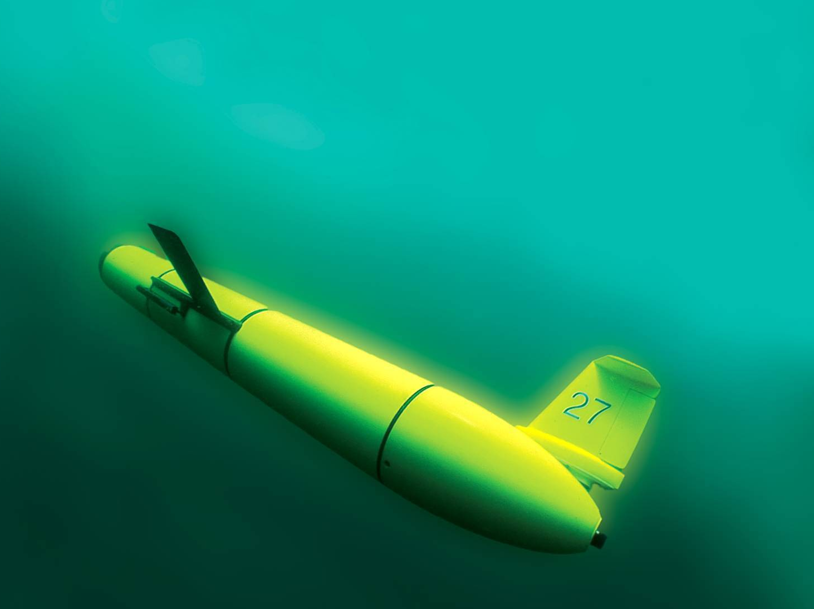
The Use of Real-time Data from Globally Distributed Glider Missions in the Undergraduate Classroom
Scott Glenn, Oscar Schofield, Josh Kohut,
Janice McDonnell, Katie Gardner (LSC),
Tim Zimmerman
Rutgers University

Slide 2
Autonomous Underwater Glider Operations
Advantages – Long Duration, Flexible Sensor Payloads, Flexible Fleets, Extreme Conditions
Challenges – Low Power, Slow Speed, Biofouling

Slide 3
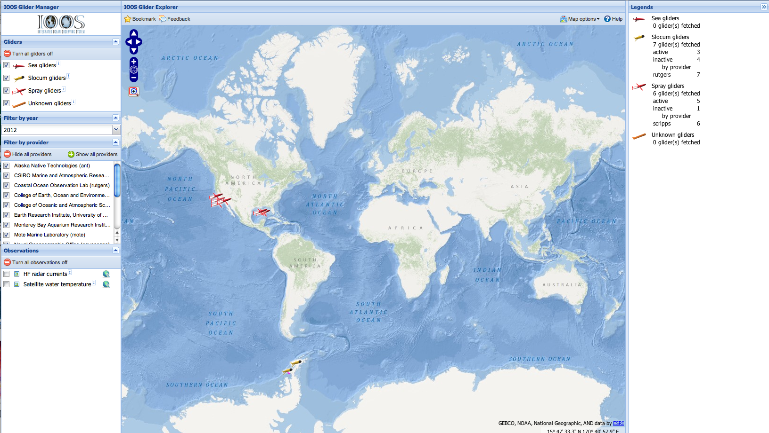
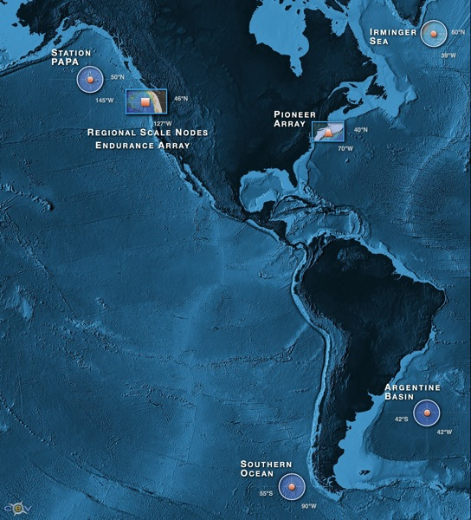
Globally Distributed Autonomous Underwater Glider Missions
A decade of Rutgers Glider Missions
IOOS Global Glider Asset Map
OOI Coastal & Global Gliders

Slide 4
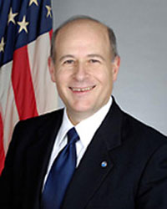
Trans-Atlantic Glider Challenge – May 24, 2006 –
UNESCO E.U./U.S. Baltic Sea Conference in Lithuania
Dr. Rick Spinrad
Assistant Administrator
NOAA
Office of Oceanic and Atmospheric Research
“I have something you need to do for the good of your country.”
“Take one of your gliders, modify it, and fly it across the Atlantic, inspiring students along the way.”

Slide 5
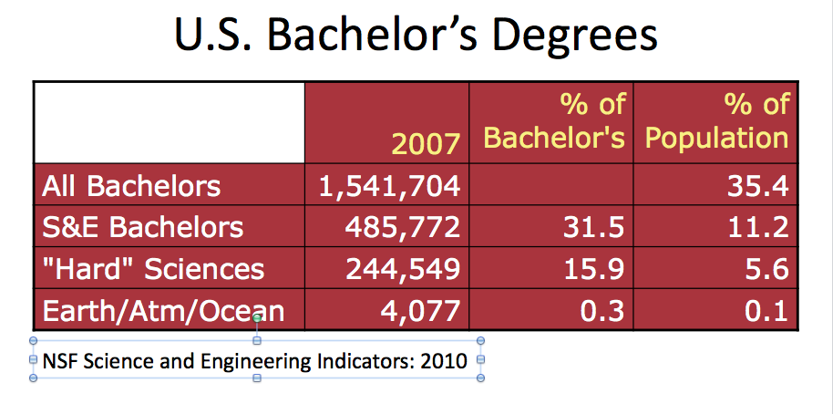
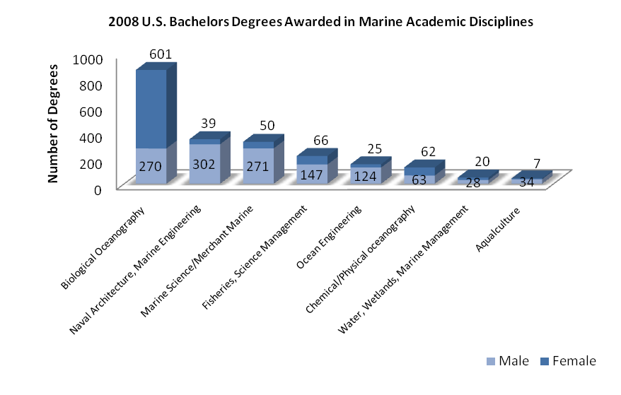
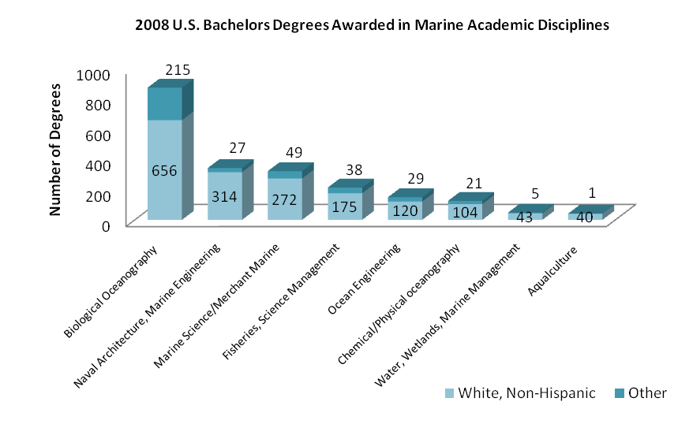
Undergraduate Education Statistics
41% Female
59% Male
18% Other
82% White, Non-Hispanic

Slide 6
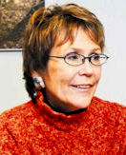
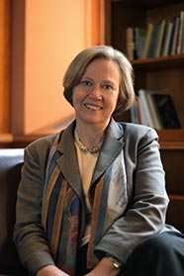
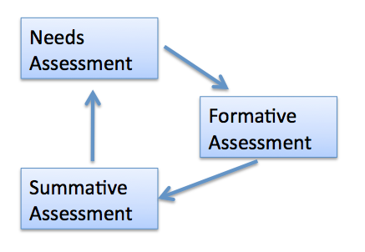
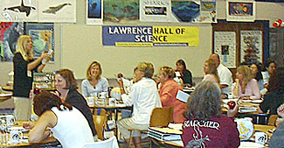
Advice From Some Friends:
Margaret Leinen – Geological Oceanography – Assoc. Provost, Florida Atlantic U.
Good news – Geoscience Majors are more likely to remain in their field.
Key to success – Mentorship – But there remains a mentorship gender gap.
Shirley Tilghman – Molecular Biology - President, Princeton U.
Good news – We know what works.
Keys to success – Turn the pyramid upside down.
Start living the life of a scientist early.
Distribution classes taught within discipline.
Catherine Halversen – Lawrence Hall of Science – You can do it (we can help you do it).
Chris Parsons – Word Craft – Don’t forget to layer-on the assessment cycle.

Slide 7
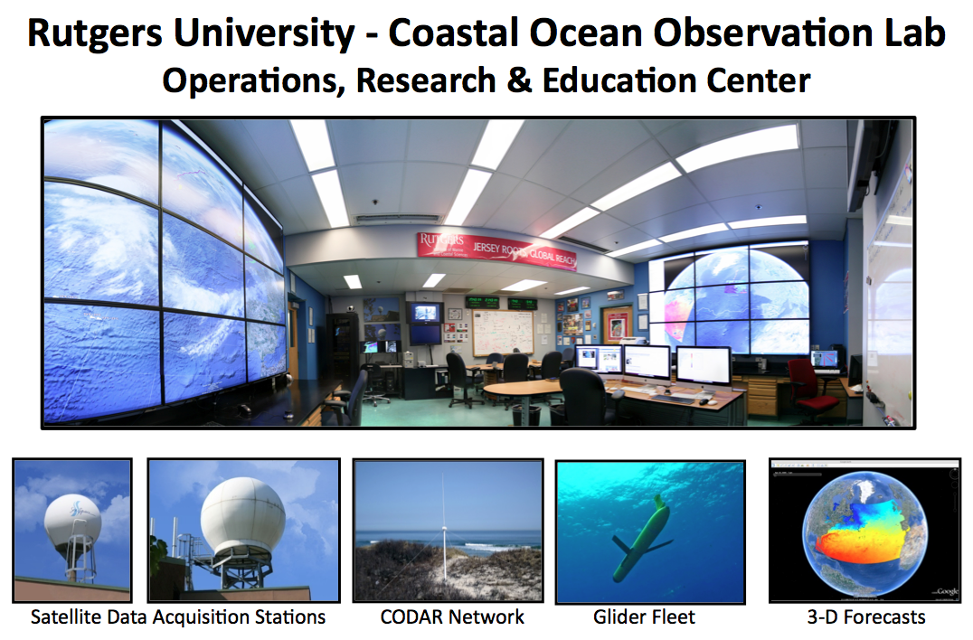
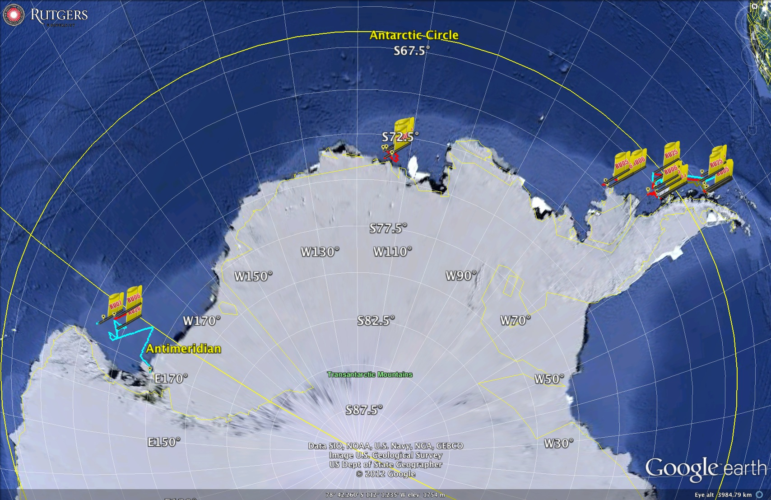
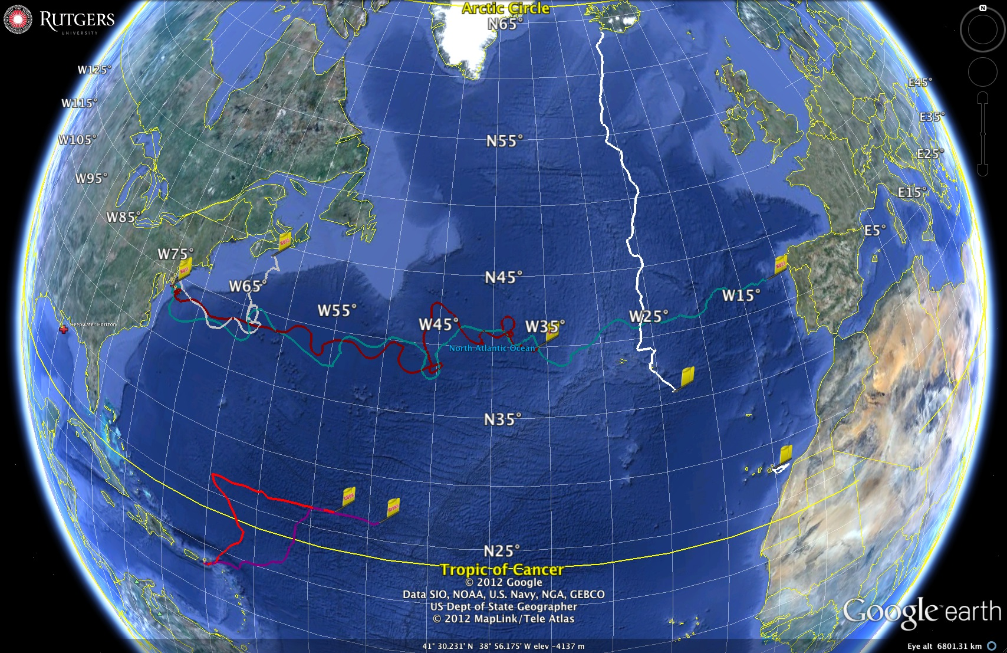
Regional Observatory - Mid-Atlantic
Remote Observatory - Antarctic
Global Observatory

Slide 9
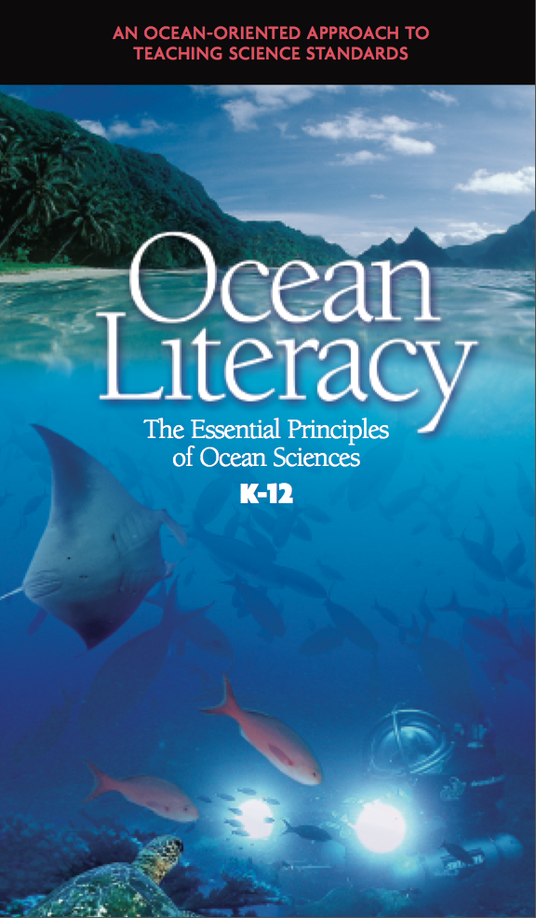
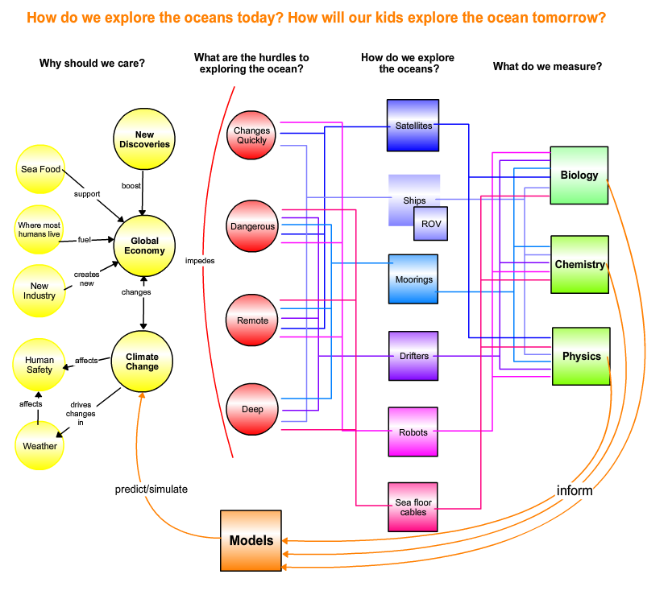
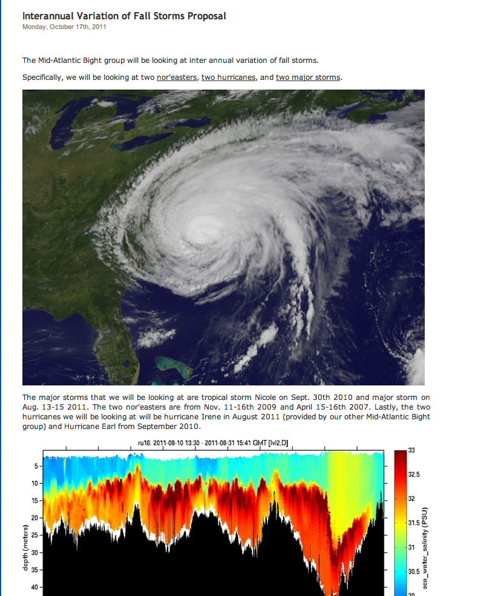
What COSEE Provided:
COSEE – Network: Ocean Literacy Principals
COSEE – CA: Communicating Ocean Science series (COS, COSIA, COSIA-Lite)
COSEE – MA: Cultural Competency
COSEE – NOW: Distributed Learning Communities (Blogs, Webpages).
COSEE – OS: Concept Mapping
COSEE – NOW: ONR Marine Technician Workforce Study
Essential Principals
Concept Maps
Blogs

Slide 10
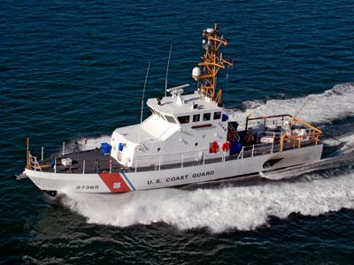
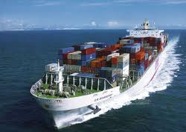
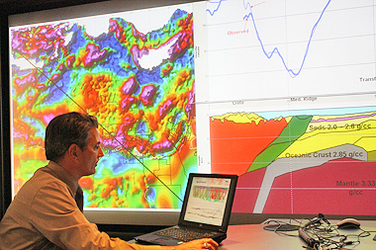
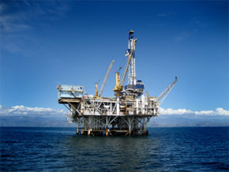
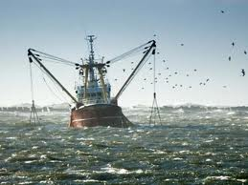
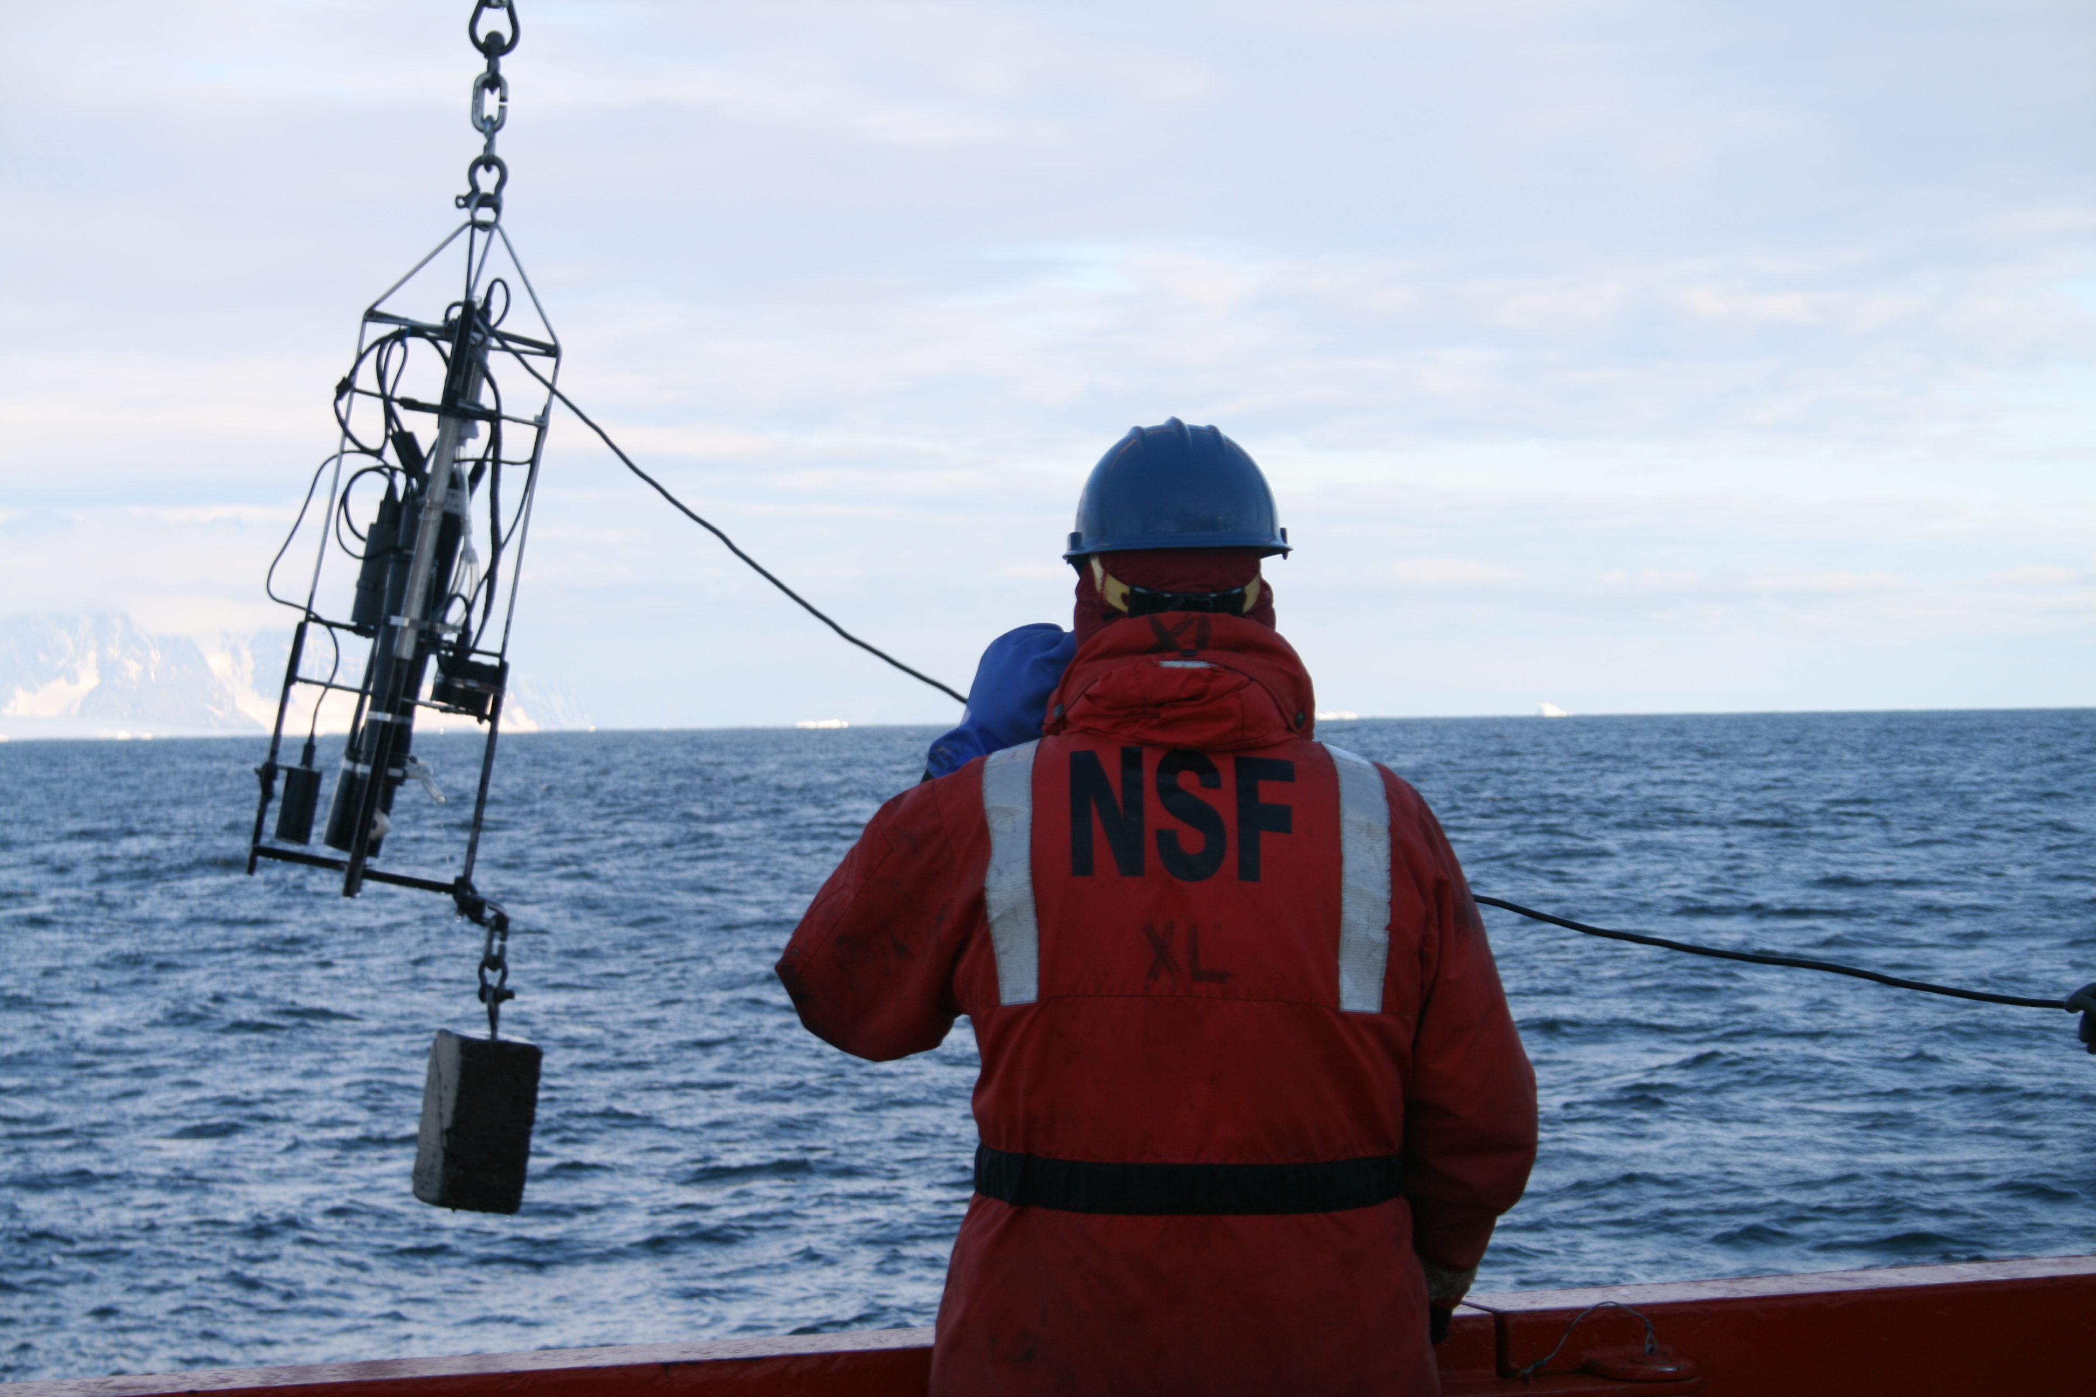
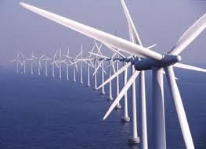
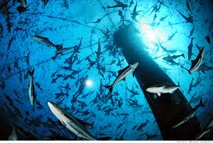
Needs Assessment
- Example: How should universities educate the future ocean workforce?
Graduate Programs: need strong science/math backgrounds, and increasingly look for research experience.
Federal Agencies: Also needs Bachelors & Masters graduates. Not just Ph.D. Researchers.
Companies: seeking people with a range of technical
abilities and Team Working Skills. Not just Ph.D. Researchers.
MATES & NPS Assessment of Marine related Jobs
Nationally in 2007, only 4000 (0.3% of the 1,542,000) Bachelors Degrees were in Earth/Ocean/Atmospheric Sciences.
Need to increase STEM interest within a diverse K-12 pipeline.
Provide Undergrads real-world working-team experience.
Cognitive Apprenticeship.
Strong written and verbal communication skills emphasized by employers
Cross-disciplinary training highly desired (Oceanography combined with other disciplines Atmospheric Science, Computer Science, Engineering, Economics, Communication, Foreign Language)
Workforce of future industries

Slide 11
Formative Assessment –
Continuous Re-evaluation and Redesign of Undergraduate Curriculum
Theory Courses
Feeder Courses
Marine
Ecosystem
Dynamics
Urban
Estuaries
Graduate Intro to
PO, BO, CO or GS
Oceanography
101
Courses
Skills Courses
Freshman
Seminars
Ocean Methods &
Data Analysis
Communicating
Ocean Science
Oceanography
House – Learning Community
Team-based Research Apprenticeships
Ocean Observatories Research Course –
a) Regional, b) Remote, c) Global
Independent Research
Summer
Internships
Senior
Thesis
2-Way International Exchange

Slide 12
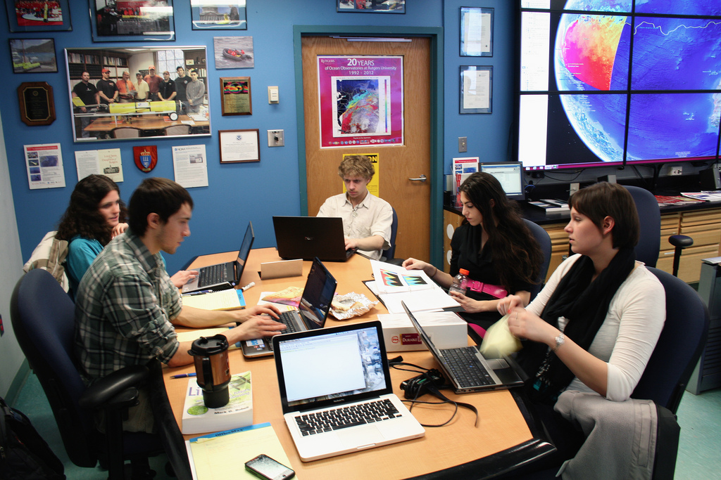
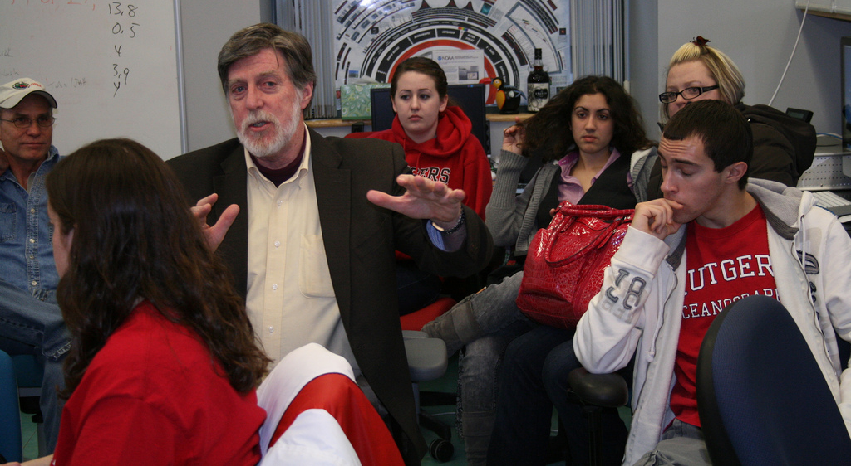
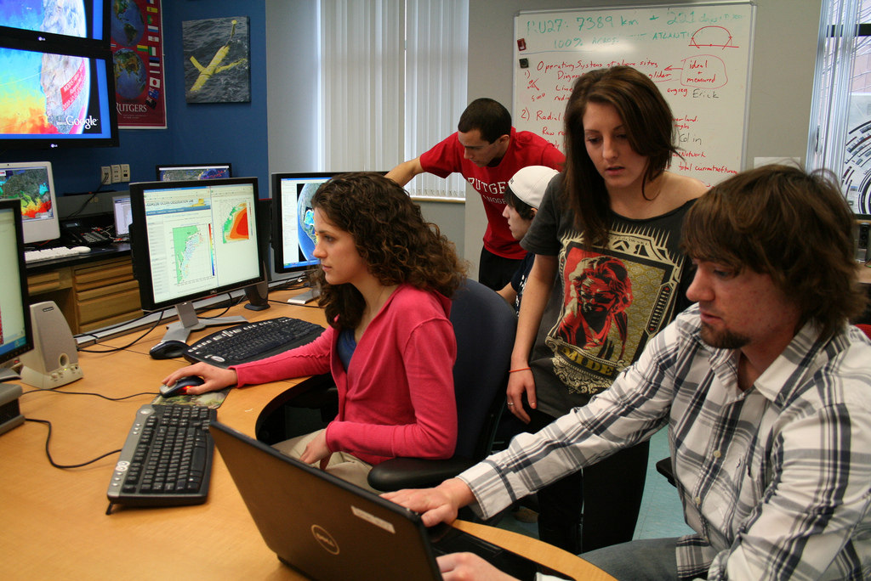
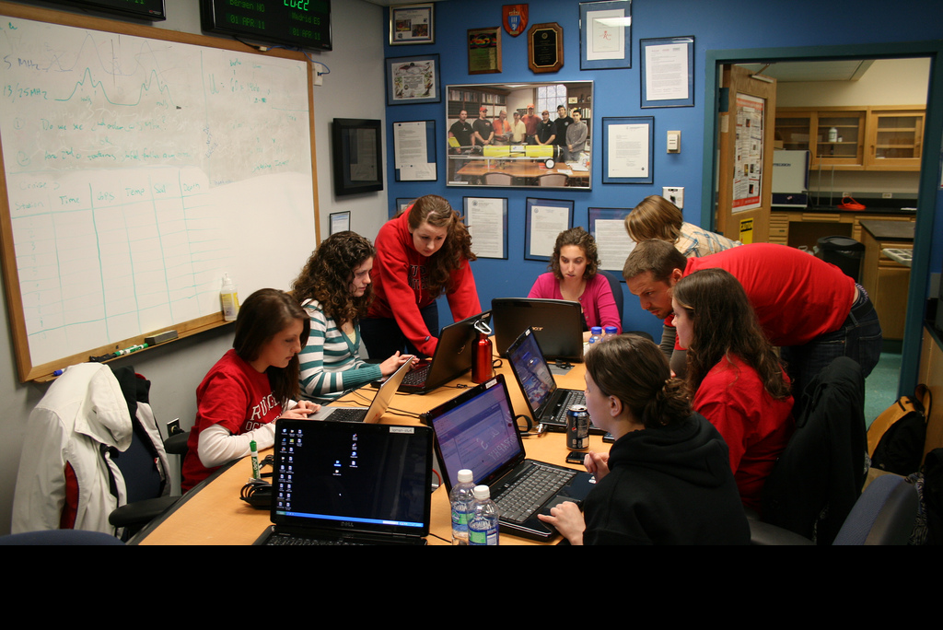
Team-based Research Apprenticeships
Course Mechanics:
Marine Science Major requires 6 credits of Research.
Ocean Observatories course is 1.5 credits –one 80-minute class period per week.
Students can sign up multiple times.
What we (the teachers) do:
1) Mentorship Model – Cognitive Apprenticeship – Experiential
Watch One -> Do One -> Teach One
(Observer -> Worker -> Mentor)
2) Grand Challenges can only be achieved through sustained teamwork – research now bridges semesters and summers.
3) We do not fear failure – Undergraduate Education is a time for exploration and risk-taking.
What the students do:
Divide into research teams led by a mentor (teach one), and consisting of a few workers (do one) and a few observers (watch one).
Propose and conduct a team research project based on ocean observatory data.
Communicate results through blogs and presentations.

Slide 13
Formative Assessment –
Continuous Re-evaluation and Redesign of:
Ocean Observatories Research Course
Feeder Courses
Skills Building
Background Discussions
Full Class Logistics & Info Sharing
Team Projects
Repeat Students 3-6 Times
Mentors
Mentors
REG
I
O N A L
RE M O T E
G
L O B A L
Repeat Students 1-3 Times
Workers
Workers
Freshman Oceanography House
Observers
Observers
Oceans 101
Freshman Seminar
COSEE Network
OOI EPE Tools
Ocean Observatories
Dark blue are the students in the light blue course

Slide 14
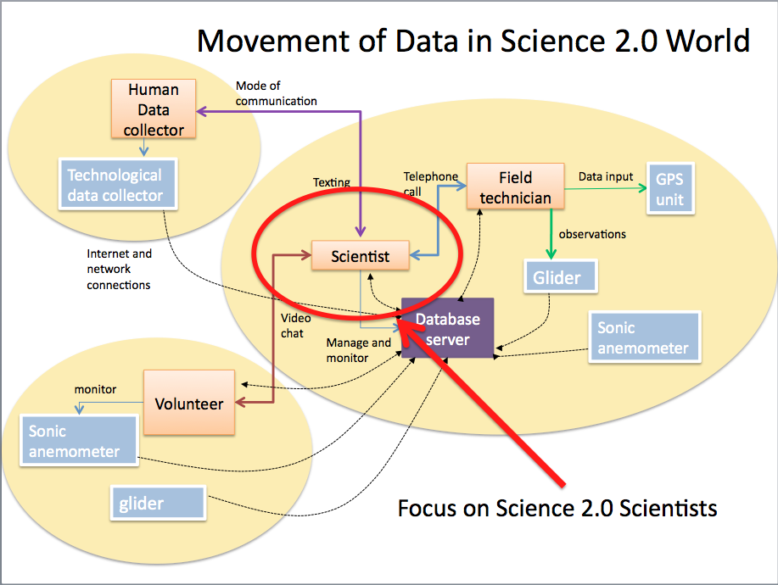
Preparing Future Science 2.0 Scientists
From Tim Zimmerman
T: “We must explicitly point out when and how our work is Multiplatform and Multimodal.”
S: “During a glider mission, I will have many technology platforms open and I will share information and data in many different ways.”
T: “We must develop new pedagogical strategies that make Multiplatform and Multimodality explicit for students at different stages in their education.”
S: “The Ross Sea Glider story - The students will never forget that day in class”.

Slide 15
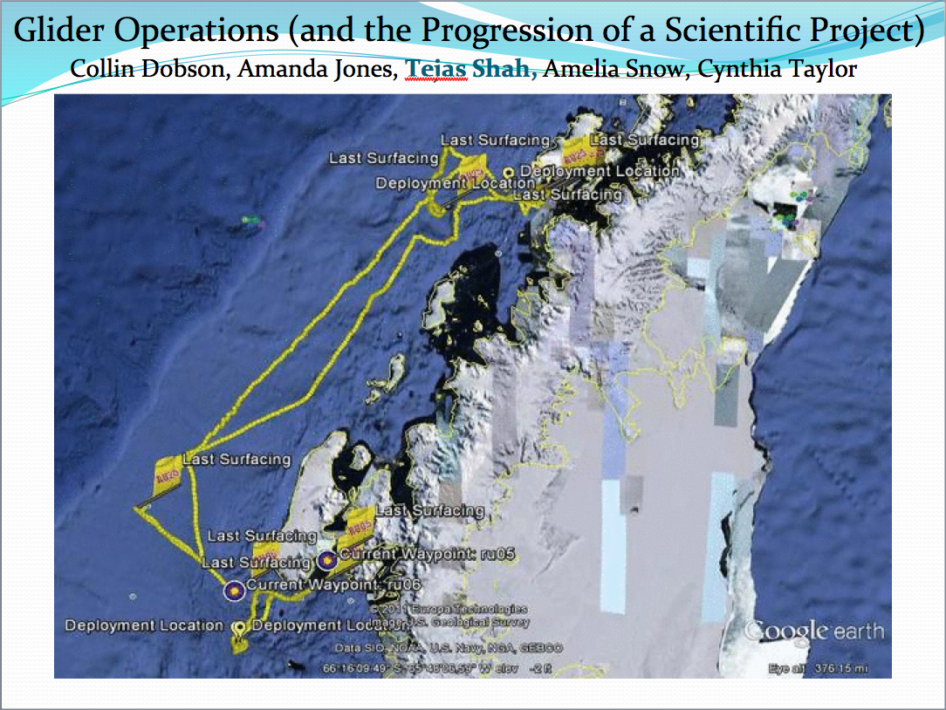
Regional Observatory - Mid-Atlantic
Ocean Observatories Research Course Grading:
Class Attendance – required – sign in sheet
Peer Evaluations – Mentors grade team members, team jointly grades mentors
Midterm – Team Research Proposal – Concept Map
Final – Team Research Results – Posters & Powerpoints
Remote Observatory - Antarctic
Global Observatory

Slide 16
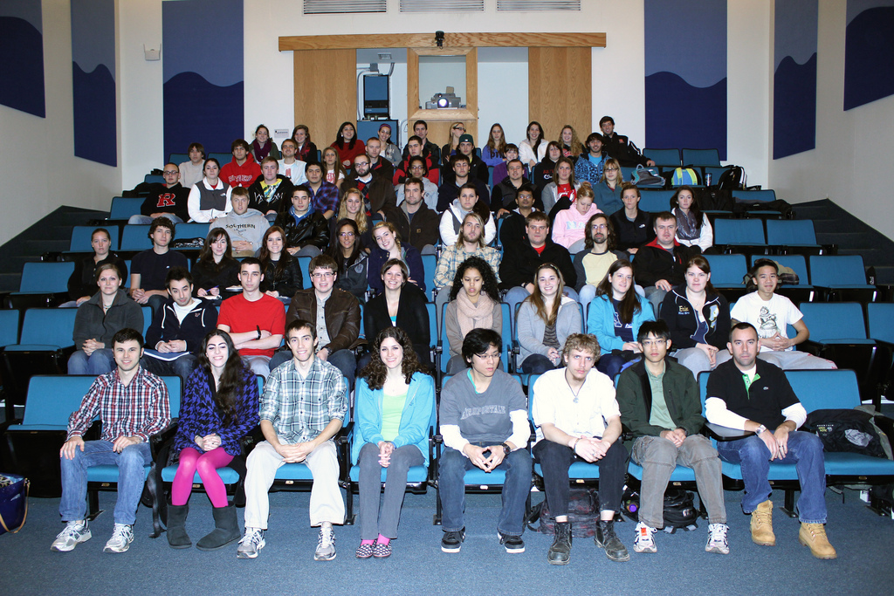
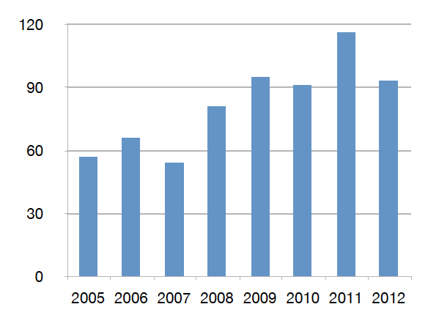
Summative Assessment – Did we have an impact?
Increase in Number & Scope of Research Internships
Locations: Australia, Antarctica, Svalbard, Spain, Canaries, Azores, California, Florida, New Jersey
Sponsors: NSF, DHS, Alumni
Trans-Atlantic Glider Challenge
Spring 2012 Course: >70 Students
Number of Marine Science Majors

Slide 17
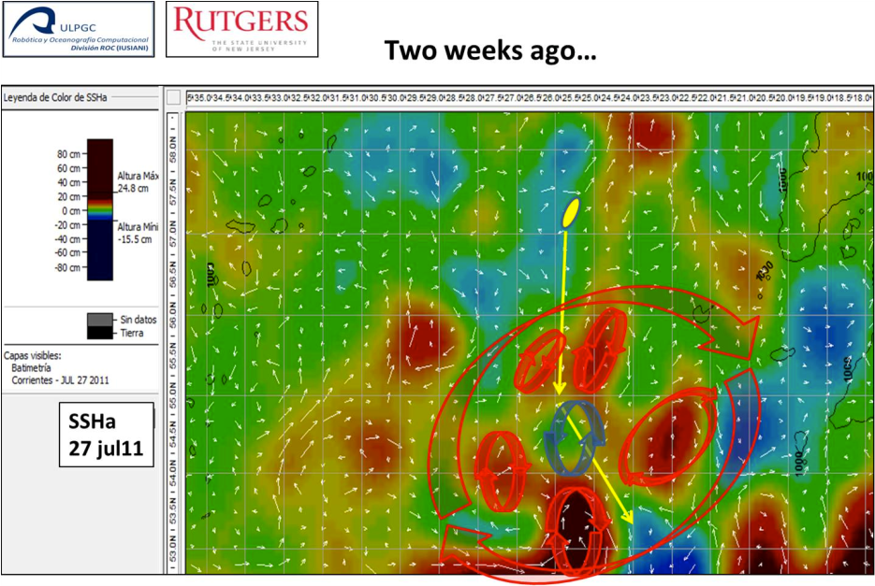
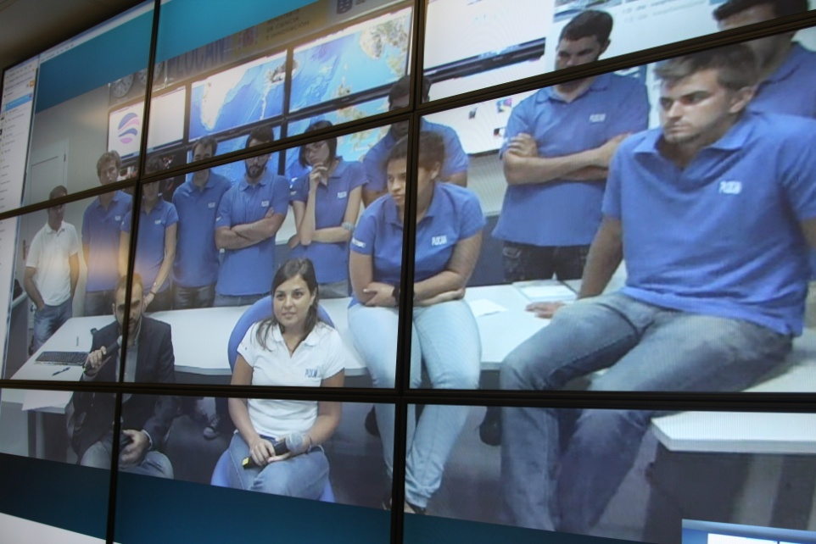
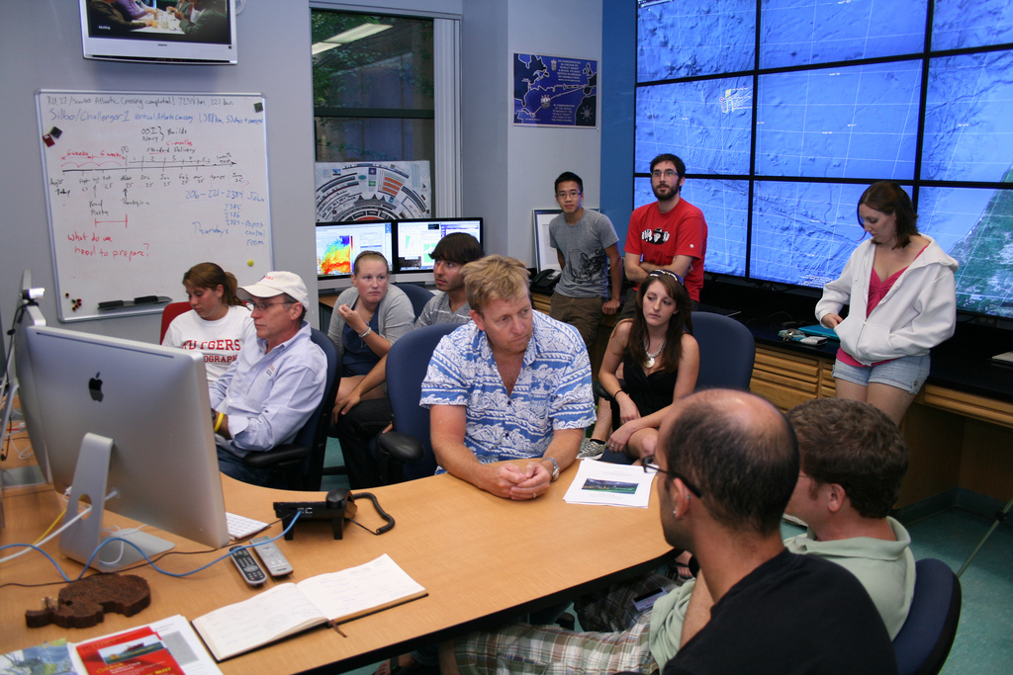
FAQ: Is it expandable?
Companion Course at
Plataforma Oceanica de Canarias
Shared Glider Missions – Iceland to Azores
Skype Sessions between classes
Two-way International Exchange programs
Students Learn Science from their teachers
Students Learn Culture from their peers

Slide 18
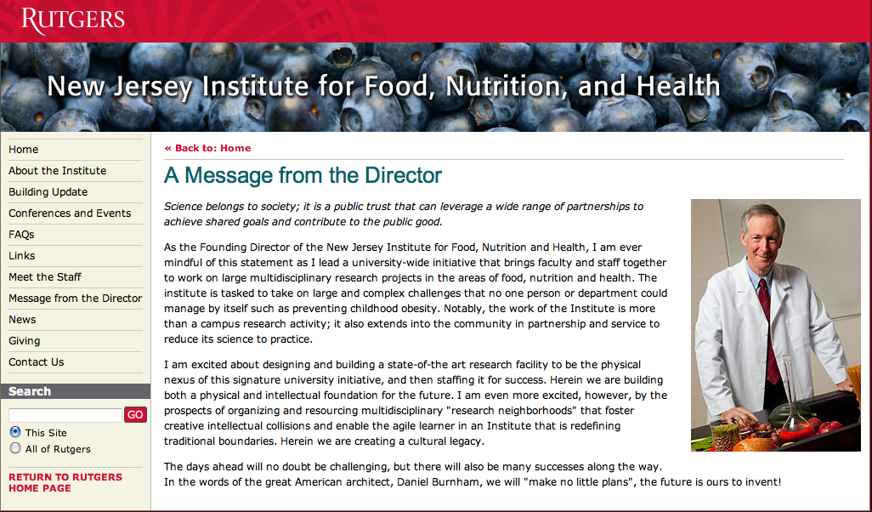
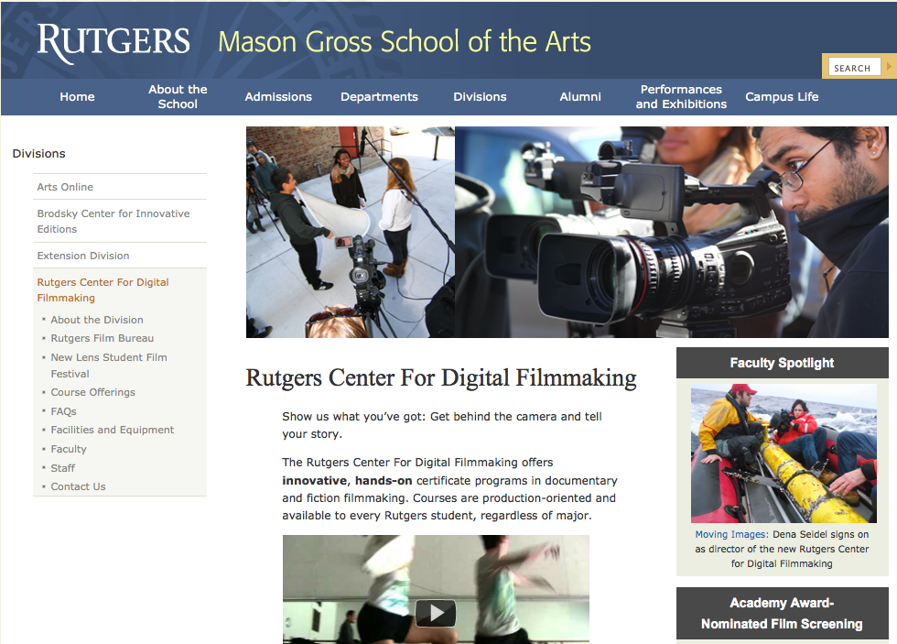
FAQ: What if I don’t own a fleet of gliders, can it be downscaled?
Yes, similar programs are spinning up in other departments across campus.
Food Science – Laboratory programs in Food & Nutrition are planned.
School of the Arts – Student Film-making programs have been established.

Slide 19
Barriers Encountered,
and
Ocean Observing Initiative (OOI)
Education and Public Engagement (EPE)
Tools to Respond
1) Barrier: Data Visualization – The Ability to Create New Knowledge.
All Groups actively & effectively use Google Earth for horizontal mapping.
All Groups reported frustration with Matlab for data analysis and visualization.
OOI EPE Tool: Data Visualization Services – Developed to specifically enable undergraduates to explore OOI datasets and create new knowledge.
2) Barrier: Team Organization – Providing the structure to organize a team research project.
OOI EPE Tool: Concept Mapper – Being used in class to organize research concepts and the people working on them.
3) Barrier: Course Organization – Providing a flexible structure to organize and share course activities, background material, and feedback.
OOI EPE Tool: Lab/Lesson Builder – Will be used to organize across team projects both locally and with companion courses taught elsewhere.

Slide 20
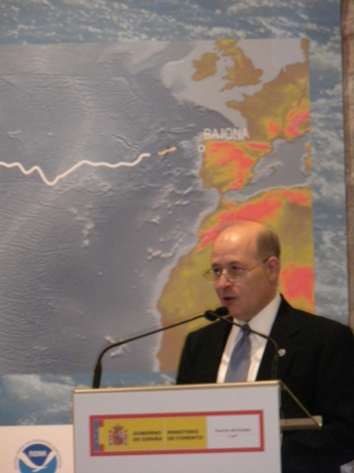
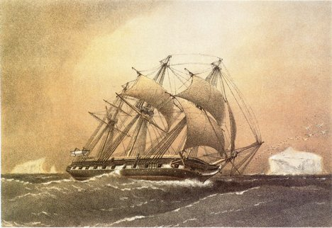
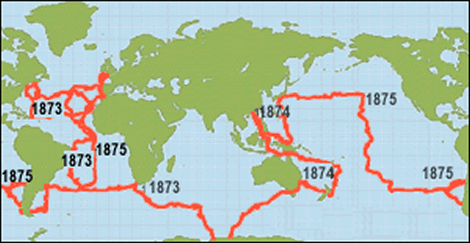
Global Glider Challenge – The Challenger Mission
December 9, 2009 – Baiona, Spain
NOAA Rick Spinrad’s Challenge:
Build a Global Glider Fleet
and Coordinate the First Robotic Circumnavigation.
Revisit the Track of the
HMS Challenger –
And inspire a global network of students
along the way.
Student Response
HMS Challenger Voyage
First Scientific Circumnavigation
1872-1876
128,000 km =
= 16 gliders x 8,000 km/glider

Slide 21
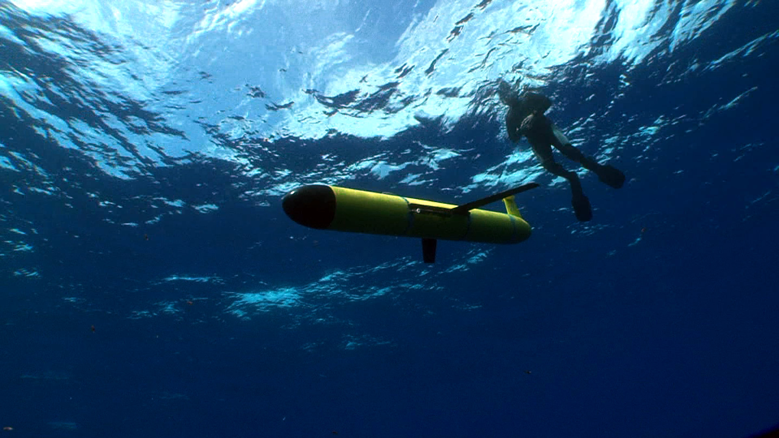
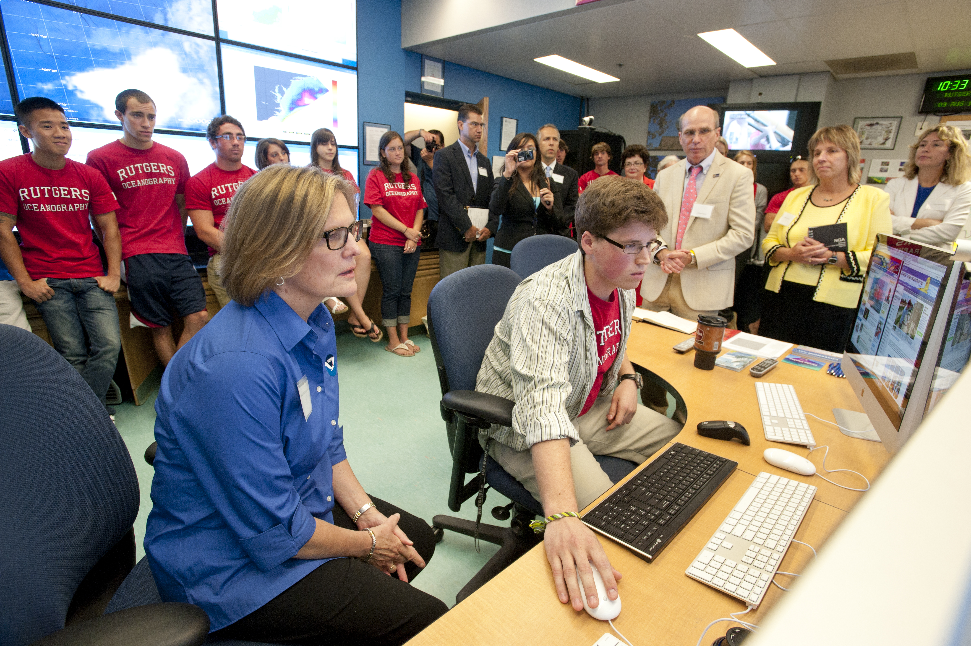
What did the students get out of this?
Experience Multimodal Multiplatform Science
Numerous speaking opportunities – Learn to Communicate.
Research on their Resume.
Leads to Summer Internships – National & International.
Leads to Graduate School Acceptances.
Leads to Job Offers from Glider Operations Centers.
Leads to higher rankings in the environmental job market.
Meet national and international leaders in oceanography.
Develop friendships that persist across space and time.
They return to tell others of the importance of this experience.

Slide 22
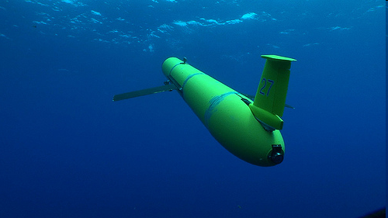
What did we (the teachers) get out of this:
The distinct line between research and education is gone – It is now just a broader, continuous spectrum of activity.
What we learned about education, we now apply back to a much wider range of research & outreach.
The accomplishments of the teachers and students have been nationally recognized.
Thank you COSEE!

