Slide 1

Who’s Helping Whom?
The multifaceted value of engaging ocean scientists in professional learning communities
Laura Dover-Good
Michelle Mileham
Oregon State University
AGU Ocean Sciences Meeting, Feb 2012

Slide 2
A professional learning community works toward shared goals
A group with a common vision for educational and learning outcomes
It is a shared enterprise
PLC participants are both facilitators and learners
Notes:
Four building blocks: Mission, vision, values and goals (DuFour & Eaker, 1998)
Rogoff/lave and wenger communities of practice
Attributes of Professional Learning Communities
The literature on professional learning communities repeatedly gives attention to five attributes of such organizational arrangements:
supportive and shared leadership,
collective creativity,
shared values and vision,
supportive conditions, and
shared personal practice. (Hord, 1997)

Slide 3
There are players in a PLC
Public Audiences
Scientists
Educators
Notes:
Give examples of each type of players and explain how their vision can be shared

Slide 4
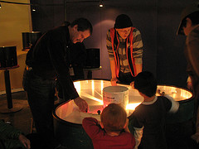
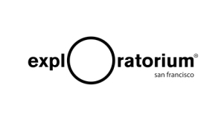
Environmental Scientist in Residence Program
Exploratorium, San Francisco
12 scientists over 2 years focusing on ocean and atmospheric sciences
Scientists work with ~90 explainers
Public audience ~600,000 visitors per year

Slide 5
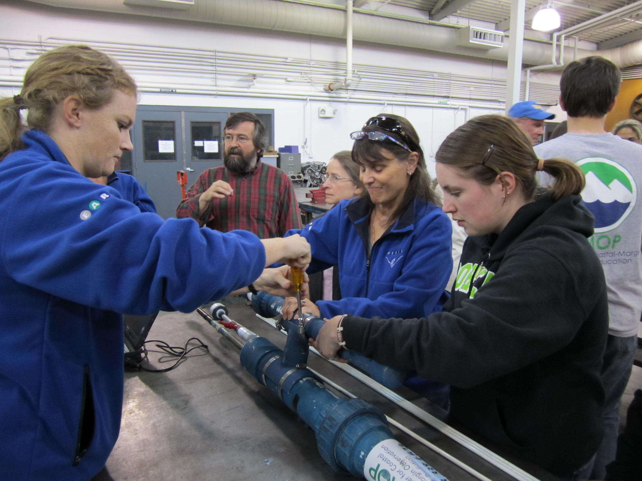
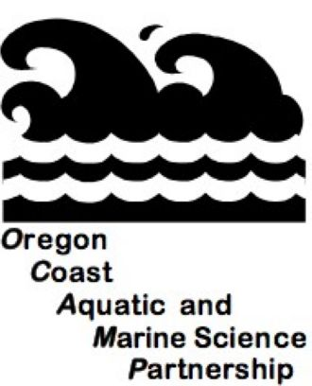
OCAMP
Lincoln County, Oregon
Math and science partnership
32 K-12 teachers
5 informal science institutions and their educators
~35 scientists over 3 years

Slide 6
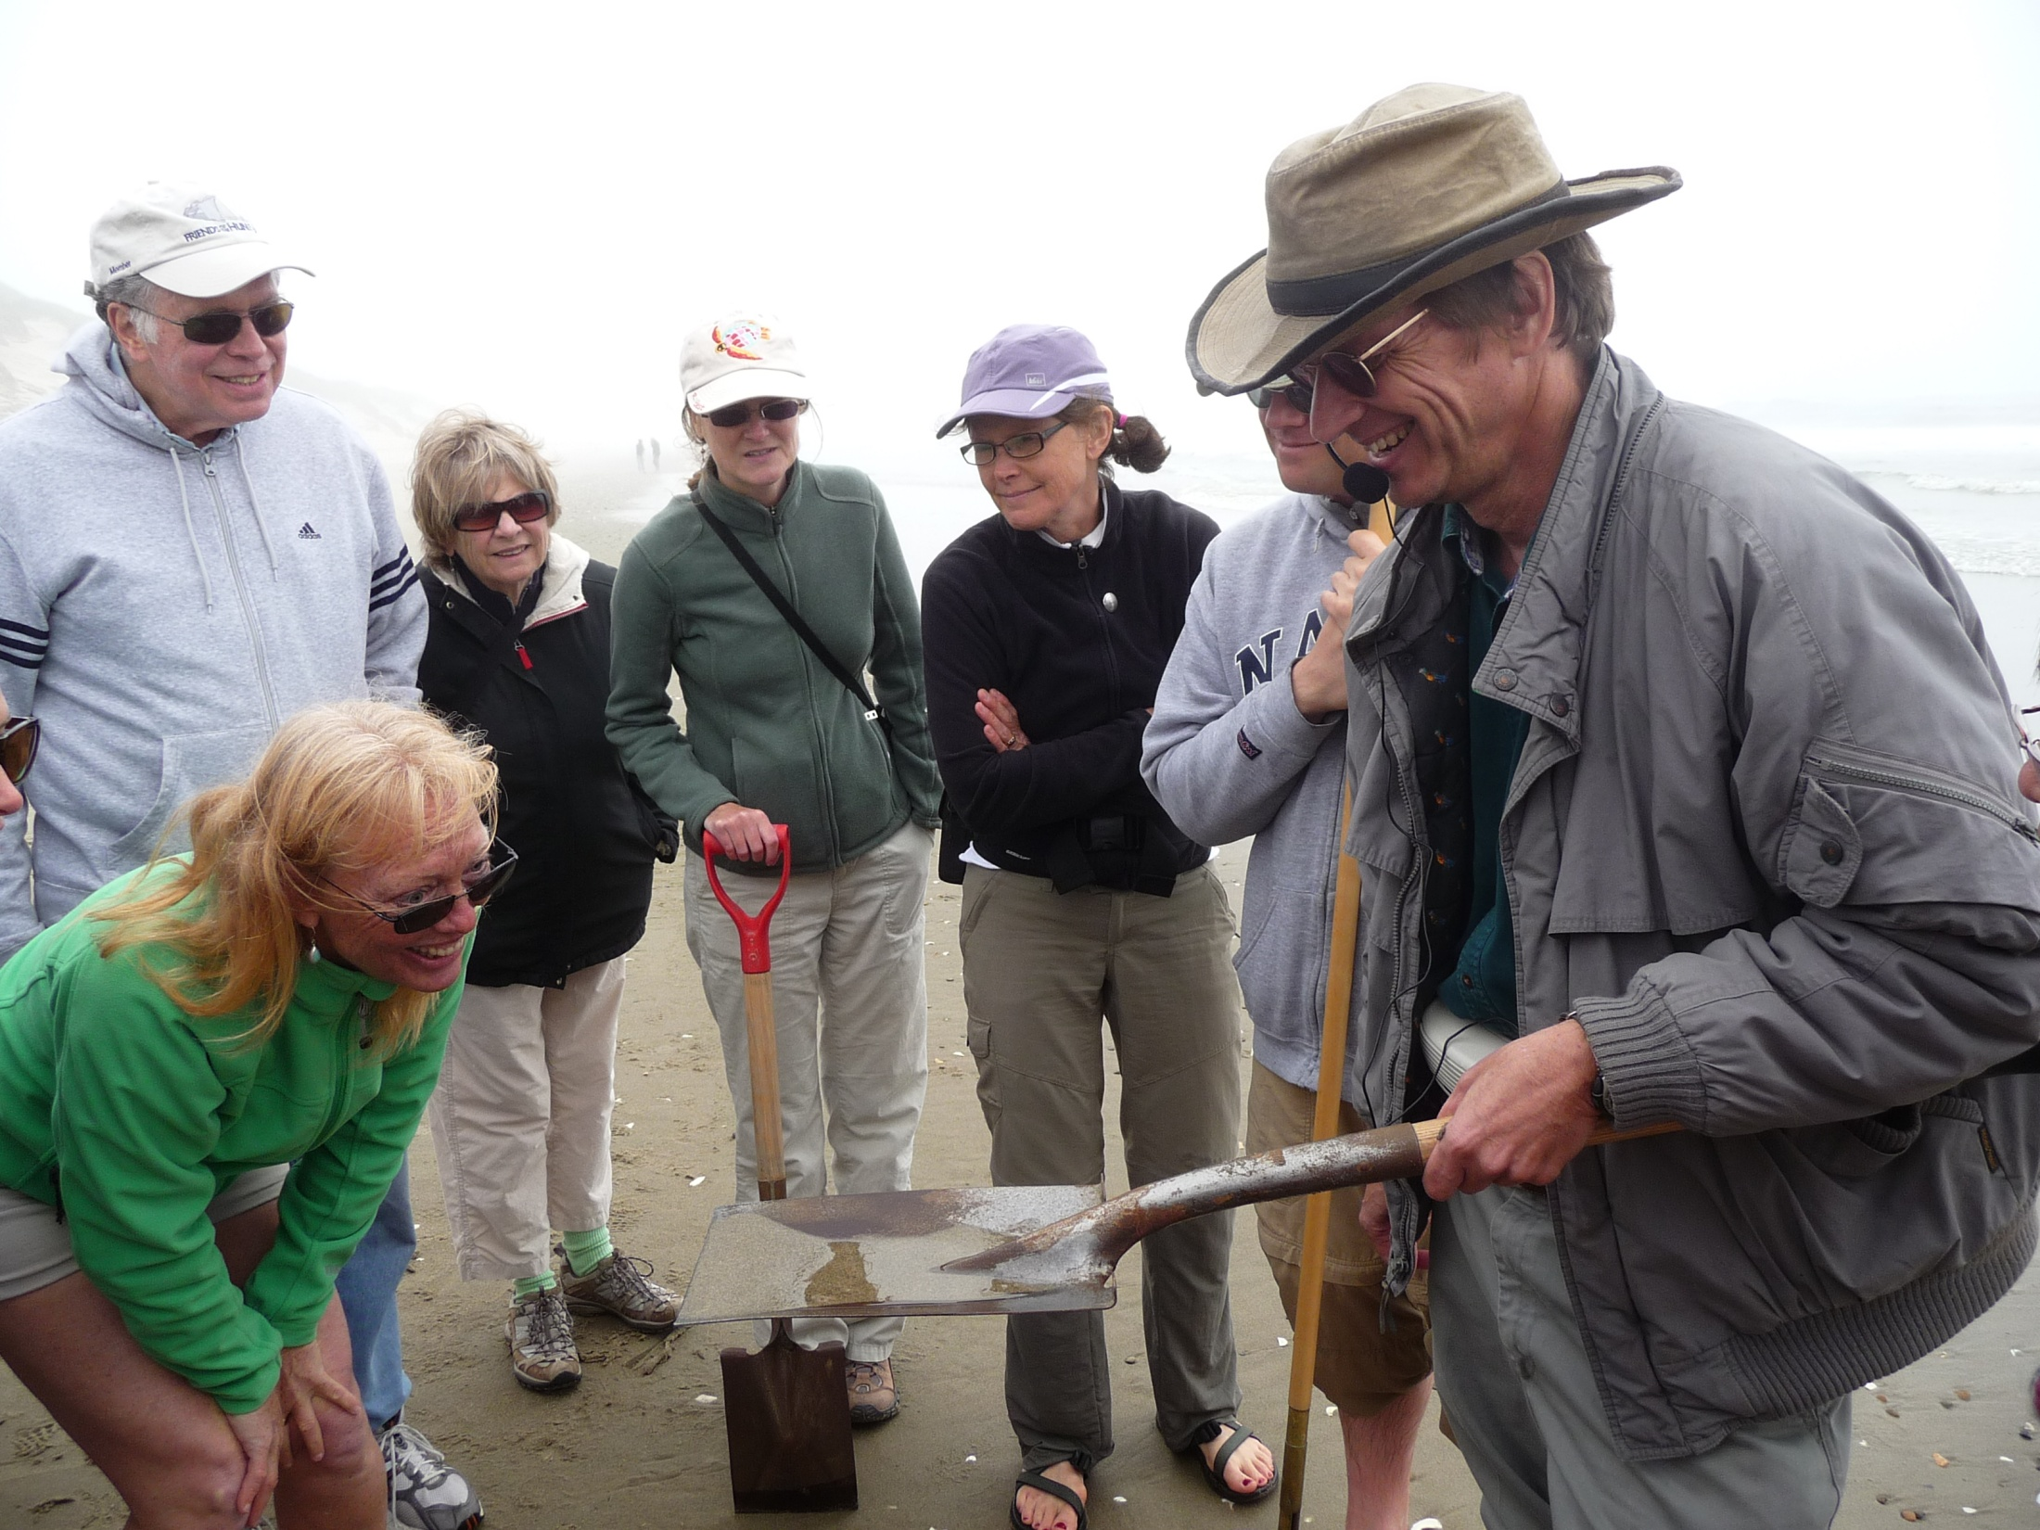
Coastal Master Naturalist Program
Workshops across coastal Oregon
During 2010-11 pilot:
  8 scientists/university extension agents
  274 Participants, where ~1 in 3 attended multiple sessions
Professional development for volunteers who interpret science to the public.
Notes:
274 total, 100 male, 174 female
104 unique participants, 33 male, 71 female

Slide 7
Recent evaluation findings show PLCs support scientists as both givers and receivers
Scientists are not only research experts in PLCs, but also learners
Developing models of PLCs for the field
This professional development is an ongoing process, even after project completion
Notes:
Understanding that they are also a learning in a PLC helps them to move forward in their thinking around communicating ocean science as a form of professional development.
Scientists as learners is often an afterthought from such projects, while in reality more effective use of the PLCs is to take account of these points in the pre planning stages of these types of programs

Slide 8
The value of PLCs is multifaceted
All players influence one another
Public Audiences
Scientists
Educators
Notes:
All players interact, directly and indirectly. All players influence one another. Everybody wins!
Educators: knowledge on how to interact with a variety of public audiences; what public audiences want from an experience (must be quick, no jargon); the Explainers model interactions for the scientists during both residencies;
- Scientists: bring knowledge of new, exciting research in their field, both for public audiences and educators
- Public Audiences: know what they want to learn; choose their level of engagement
Educators to scientists: teachers have access to sites and scientists; scientists have access to k-12 classrooms (where they can aid teachers, learn how to communicate); educators learn specific science content
Scientists to public: scientists reach the public with their new research; communicate their work to variety of audiences; learning content from "experts“ ** feedback from public on what they want

Slide 9

Thanks!
Laura Dover-Good: doverl@onid.orst.edu
PhD Candidate, Science & Math Education, Oregon State University
Michelle Mileham: milehamm@onid.orst.edu
PhD Student, Environmental Sciences, Oregon State University

Slide 10













Project Partners
Coastal Master Naturalist http://www.coseepacificpartnerships.org/programs/iseis/cmnp/
OCAMP http://ocampmsp.webs.com/
Environmental Scientists in Residence Program http://www.exploratorium.edu/
*This presentation was prepared by the Exploratorium under award NA10SEC0080019 from the National Oceanic and Atmospheric Administration (NOAA), U.S. Department of Commerce. The statements, findings, conclusions, and recommendations are those of the author(s) and do not necessarily reflect the views of the National Oceanic and Atmospheric Administration (NOAA) or the U.S. Department of Commerce.
**COSEE Pacific Partnerships is funded by NSF Grant Number OCE-0731338
Notes:
References (in notes)
Hord, S. M. (1997) Professional learning communities: What are they and why are they important? Issues about change, 6(1), 1-8
DuFour, R. & Eaker, R. (1998) Professional learning communities at work: Best practices for enhancing student achievement. National Education Service, Bloomington, IN.

